Slide 1
Storytelling:
The Authentic & Fluent Organization
Lessons #9

Slide 2
Objectives of the lesson:
What is an authentic and fluent organization?
What is the framework for organizational storytelling by Janis Forman?
Janis Forman, Storytelling in Business, 2013, Stanford University Press
pages: 1-52

Slide 3

The Tree of Corporate Storytelling
Story-telling and Story-listening
Content Management
Structure of Stories
Branding in Practice
Sense-making

Slide 4
Framework for Organizational Storytelling
Specific
Business
Objectives
General Business Objectives
Build Trust
Inform, Persuade, Inspire
Fluency
Capabilities
Engaging Emotions and Intellect
Crafting the Story
Working with Technology
Foundation
Authenticity

Slide 5
Framework for Organizational Storytelling
Authenticity
Fluency
Credible
Realistic
Tangible
Truthful
Draw the attention of stakeholders by engaging their emotions and their intellect
By using the craft that makes this form of communication compelling
By using technology
General business objectives
Specific business objectives
to gain or strengthen the trust of the intended audience
and, with this achieved, to inform, persuade, and even inspire them
recruiting members to a firm
increase customer base
presenting the profile of the senior leadership to the media
building and strengthening
corporate strategy, corporate culture, corporate branding
build the business, its profits and reputation

Slide 6
Framework for Organizational Storytelling
Authenticity
Credible
Realistic
Tangible
Truthful
Words must match deeds.
Doest the story support the organization’s strategy, culture and brand?
Stories should not be monolithic expressions of organizational’s leadership; rather they should take into account the voices of significant others, such as employees, customers, and communities.

Slide 7
Framework for Organizational Storytelling
Authenticity
2007, Arthur W. Page Society
Authenticity is a guiding principle for companies in a business environment characterized as a “global playing field of unprecedented transparency and radically democratized access to information production, dissemination, and consumption.
This environment establishes authenticity as a requirement for business success.
Tell the truth: Let the public know what’s happening and provide an accurate picture of the company’s character, ideals and practices.
Prove it with actions: Public perception of an organization is determined 90% by what it does and 10% by what it says.

Slide 8
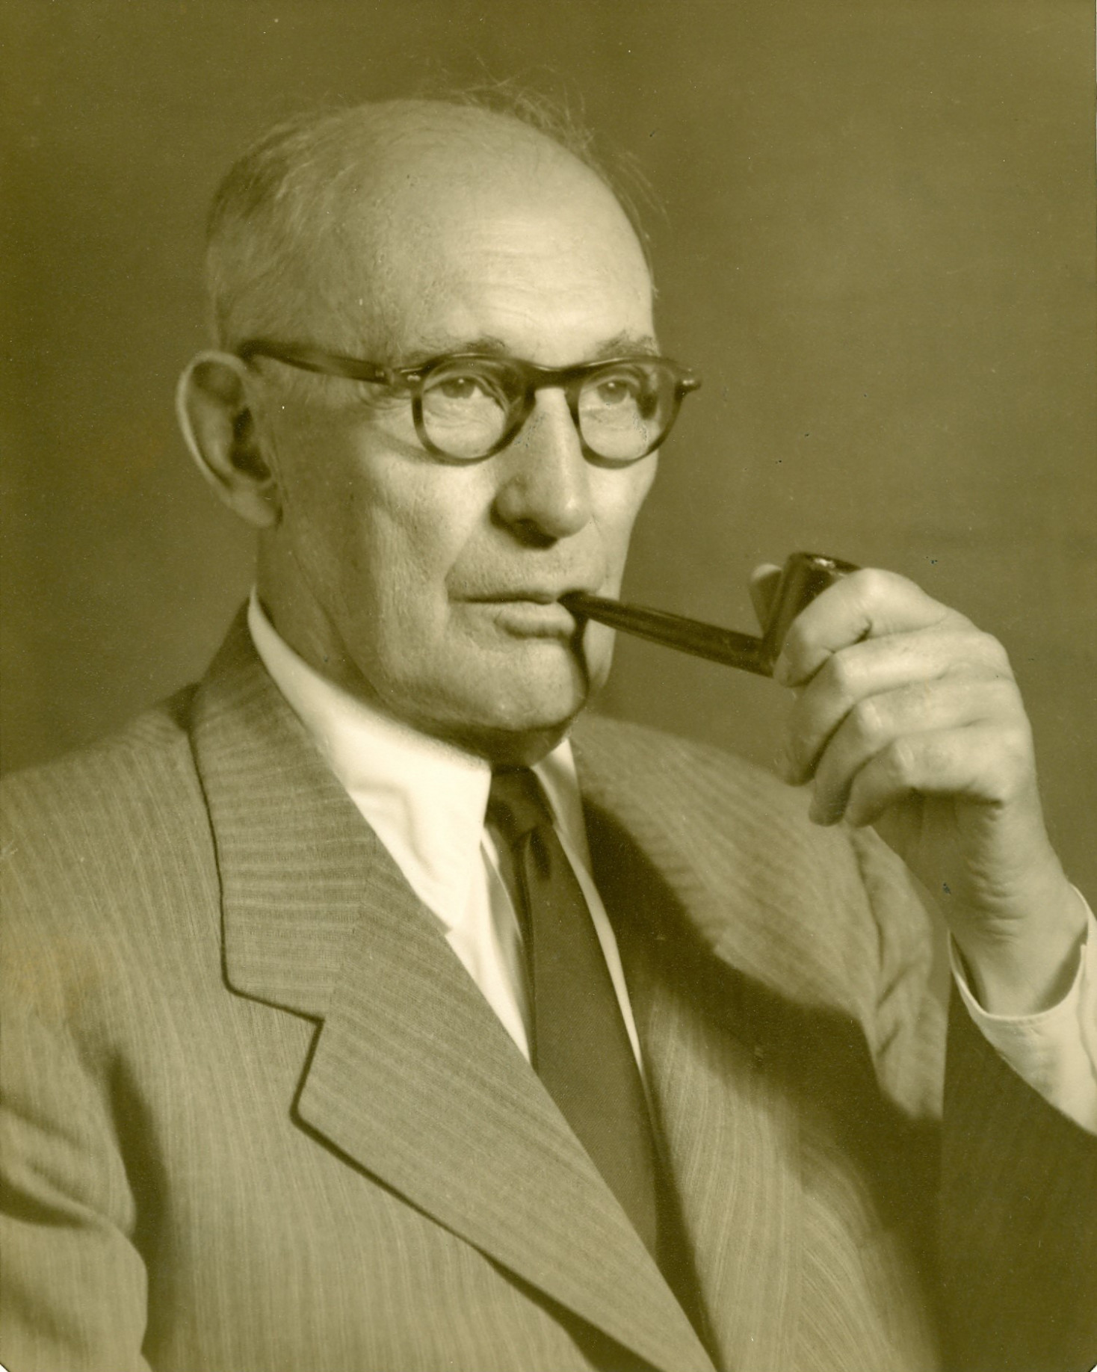
Framework for Organizational Storytelling
Authenticity
In such an environment, the corporation that wants to establish a distinctive brand and achieve long term success must, more than ever before, be grounded in a sure sense of what defines it - why it exists, what it stands for and what differentiates it in a marketplace of customers, investors, and workers.
In a word, authenticity will be the coin of the realm for successful corporation and for those who lead them.
(Arthur W. Page Society, 2007)
Arthur W. Page, VP AT&T 1927-1947, father of PR

Slide 9
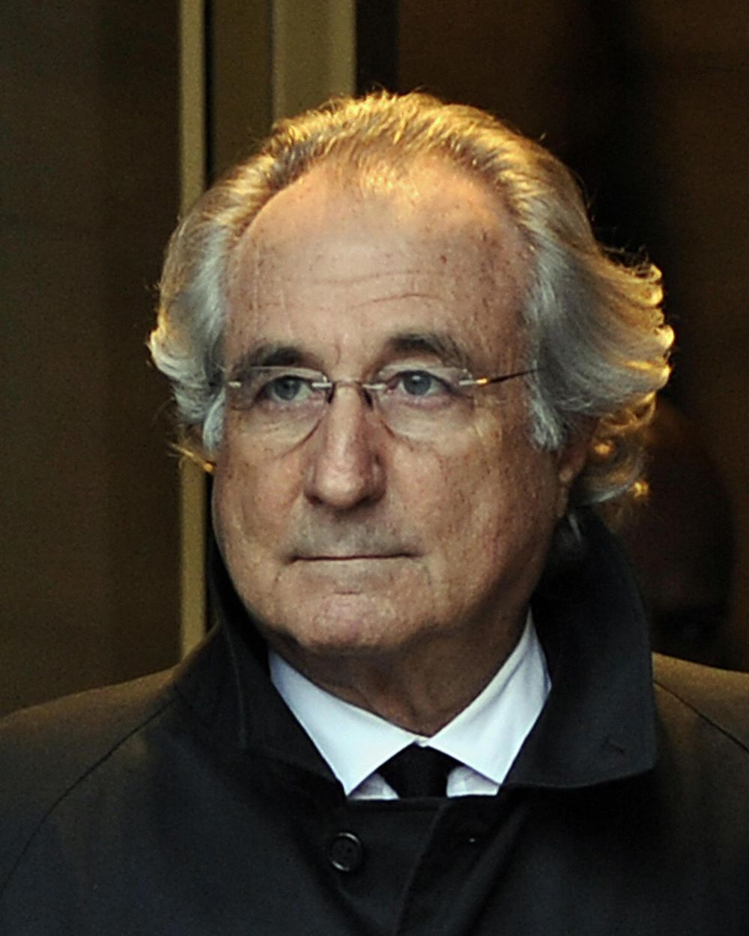
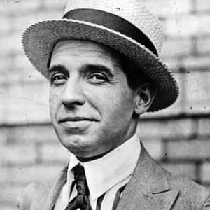
Framework for Organizational Storytelling
Authenticity
Ponzi scheme:
Investment arrangement: low risk & high return
It is not investing, it is redistribution of money from new investors to old investors
The Ponzi scheme works when there’s more money in than out
It stops when the investors can’t find newer investors
Charles Ponzi, 1882-1949
inventor of the infamous Ponzi scheme
Bernie Madoff
65 billion dollars Ponzi scheme

Slide 10

Framework for Organizational Storytelling
Authenticity
The teller needs to give scrupulous attention to the accuracy of the story’s details because the “story” of a business is often greeted with skepticism.
Authentic storytelling about an organization is data-based storytelling.
And data need to be verified using multiple sources: journalistic work!
https://www.internazionale.it/webdoc/tomato/

Slide 11
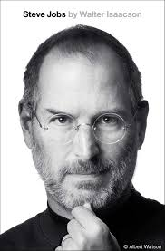
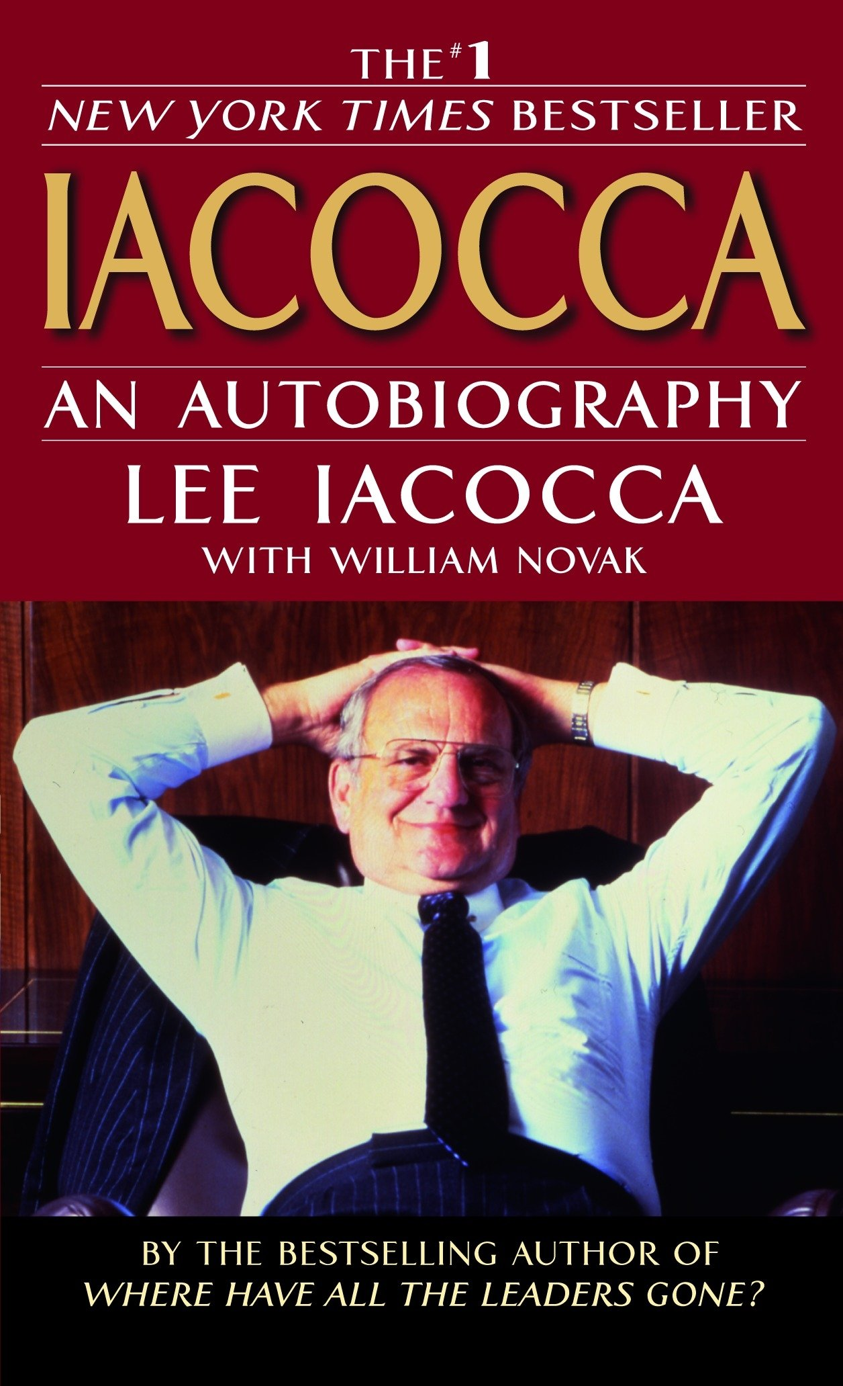
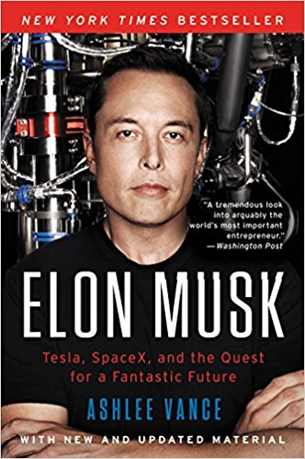
Framework for Organizational Storytelling
Authenticity
The only exception to data-based storytelling in business is: autobiography

Slide 12
Framework for organizational Storytelling
Authenticity
The Voices of Significant Others: Story-listening
They are not just accidental spokespeople, but representatives of the corporate’s brand.
Employees, end users, communities etc.
A company should include their voices in the story of the firm, and to adjust the story to their needs and concerns
Companies who miss to listen to their Significant Others result in an ineffective one-way communication.
Story-listening brings to UGC: User Generated Content. Companies should let consumers and users tell their stories.

Slide 13
Framework for organizational Storytelling
Authenticity
UGC:
75% of people don’t believe in ade, but 92% believe in brand recommendations from others
People are four times more likely to buy when referred by friends
WOM (Word of Mouth) generate 2 times more sales than paid ads
Flash Tattoos

Slide 14
Framework for organizational Storytelling
Authenticity
The Voices of Significant Others: Story-listening
Companies should encourage employee’s and users’ self-expression and individual ownership of a story
And identify specific topics the organization wants to see communicated: strategy? Culture? Branding?

Slide 15
Framework for organizational Storytelling
Authenticity
The non-authentic stories:
Emphasized stories about the CEO
Stories too good to be true
Stories with no supported data
Celebration of the entrepreneur’s charisma, narcissism and personal branding based on conviction alone than on accomplishments and values

Slide 16
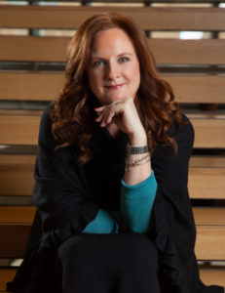
Framework for organizational Storytelling
Fluency
2.1 Engaging Emotions and Intellect
Stories need to engage people’s emotions and intellect.
Storytellers need to be fluent as well as to cut through the busyness, distractions, and competing demand of work life.
To be fluent, organizations need competence in the craft of storytelling and in the use of communication technologies.
“A great story is one that the listener can relate to, uses language that makes sense, bring in emotion, makes it visual, takes us on a journey, brings together intellect and emotion”.
Perry Yeatman, Kraft

Slide 17
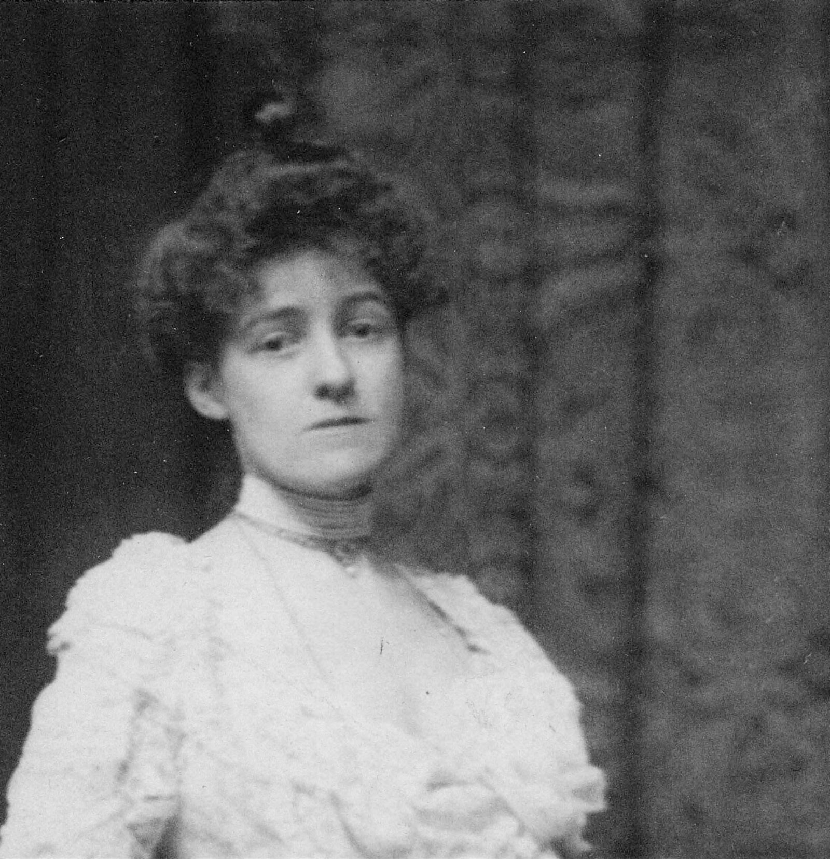
Framework for organizational Storytelling
Fluency
2.2 Crafting the Story
“General rules in art are useful chiefly as a lamp in a mine, or a hand-rail down a black stairway; they are necessary for the sake of the guidance they give, but it is a mistake, once they are formulated, to be much in awe of them” (The Writing of Fiction)
Edith Wharton

Slide 18
Framework for organizational Storytelling
Fluency
2.2 Crafting the Story
Crafting the story means to make good choices about a variety of story elements:
The Right Purpose: what purpose do you want to achieve in story form?
Audience: with whom?
Moment: why now? Roosevelt “fireside chats”

Slide 19
Framework for organizational Storytelling
Fluency
2.2 Crafting the Story
Storyteller: who should tell the story? Tone of voice!
Characters: who should be included in the story?
Novelty and the Unexpected: avoid stereotypes!
Significant Details: Little details, nuances of behavior are important to really get to know the character. Details that evoke the five senses are especially important.
Compelling Language: choose powerful words

Slide 20
Framework for organizational Storytelling
Fluency
2.2 Crafting the Story
Visuals: Visuals fortify the emotional appeal of stories
Narrative Logic: beginning, middle, end. Pulse points of a story.
Versions of stories: the ability to craft different versions of a story: which kind of language for which kind of medium? Which kind of length for which kind of channel? Details, visuals, voice, teller etc.

Slide 21
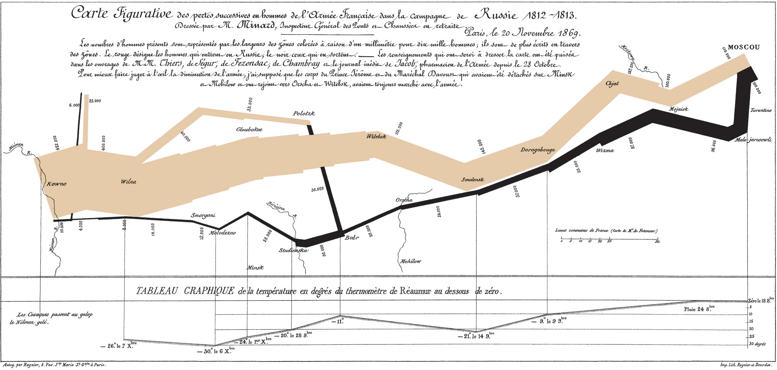
Framework for organizational Storytelling
Charles Minard, Napoleon’s Russian Campaign of 1812, (1869)

Slide 22
Framework for organizational Storytelling
Fluency
2.3 Use Technology
Communication platforms: blog, social networks, IM, forums.
The volume of communication increased drastically: how to be heard in such a noise? That’s a big problem communicators face.
Low-cost tech tools and capabilities: simple to use —> control is lost
Communication is horizontal and hierarchies have faded away.
Online, stories lose authorship and ownership

Slide 23

Framework for organizational Storytelling
General business objectives
3.1 Build Trust
The authority of the traditional media is shrinking, every company becomes a media company in that employees’ stories are important.
Trusted companies enjoy tangible benefits: increase sales of products and services and positive WOM
All the President’s men, 1976

Slide 24
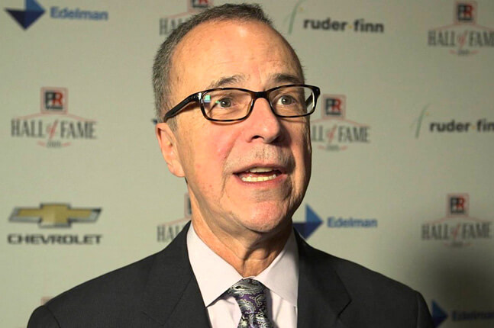
Framework for organizational Storytelling
General business objectives
3.2 Inform, Persuade, Inspire
Stories connect the things we do to the people we are.
“In an indirect way, stories can get someone to understand why we are doing something. A story can soften a prescription. I can conceal how strongly I feel about an action of my clients or staffers wants to take by telling a story with a moral. I don’t say “Don’t do it. It’s stupid. Are you out of your mind?”. Instead, I tell a story”.
Ron Culp, Ketchum

Slide 25
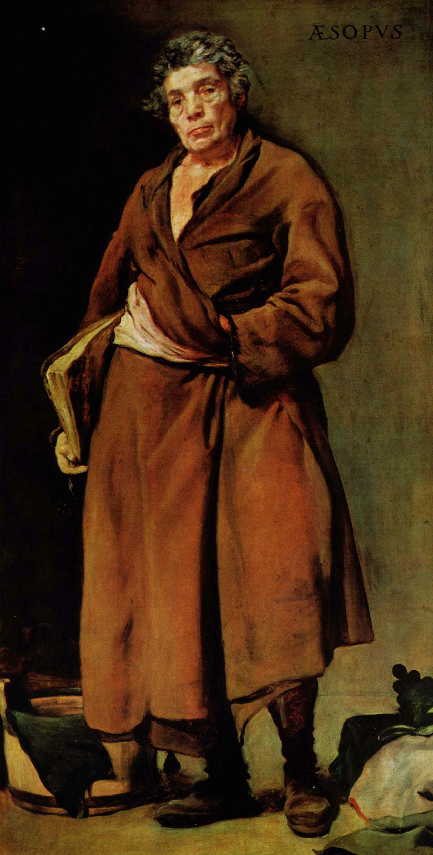
Framework for organizational Storytelling
General business objectives
3.2 Inform, Persuade, Inspire
Listeners participate, even own the stories, rather than being lectured to by an authority.
“Such stories derive much of their power from the gravitas of the storyteller: a storyteller lacking authority based on some combination of expertise, experience, track record, and formal position, or presenting a sloppily conceived or delivered story, doesn’t have a chance of changing the attitudes and behavior of an audience”.
(Walter Benjamin, Illuminations: Essays and Reflections)
Aesop

Slide 26
Framework for organizational Storytelling
Specific business objectives
4.1 Corporate Strategy, Culture, Branding
Strategy: a set of objectives, policies, and plans that, taken together, define the scope of the enterprise and its approach to survival and success. Alternatively, we could say that the particular policies, plans and objectives of a business express its strategy for coping with a complex competitive environment.
Think about strategy as a story-in-chapters. Strategy is a story about the future. The story of a projection.
Strategy guides the near and longer-term future trajectory of any organization.

Slide 27
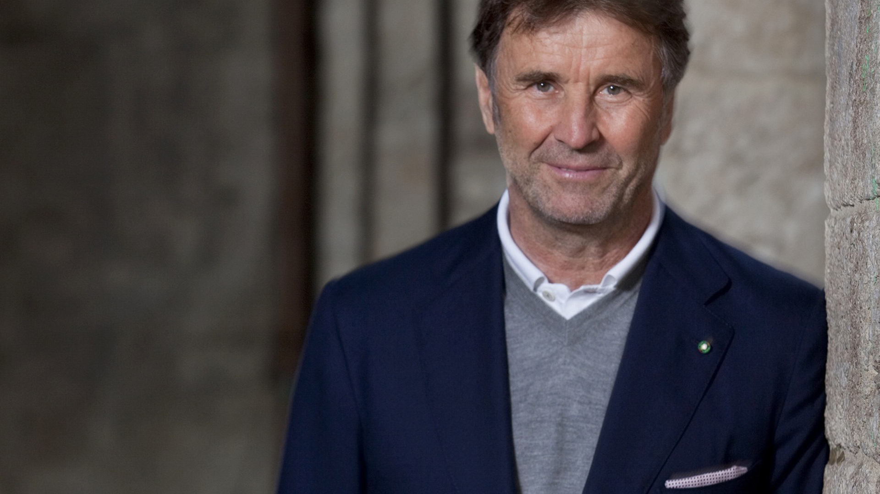
Framework for organizational Storytelling
Specific business objectives
4.1 Corporate Strategy, Culture, Branding
Culture: Today organizational stories can build, express, strengthen, and even celebrate an organization’s corporate culture.
A corporate culture is a set of shared values, beliefs and norms that govern the way people are expected to behave on a day-to-day basis.
Corporate culture: how to do things
How to think about things
How to feel as a member of that culture.
A corporate culture is the shared tacit assumptions of a group that have been learned through coping with external tasks and dealing with internal relationships.
Brunello Cucinelli

Slide 28
Framework for organizational Storytelling
Specific Business Objectives
4.1 Corporate Strategy, Culture, Branding
Branding: Brands are devices we use to differentiate between otherwise indistinguishable competitors.
Although brands can be conveyed in many ways (logos, PR, sponsorships, packaging, design etc) the role of stories is in building, supporting and conveying a corporate brand.
Corporate brands serves as a frame for stories.
A promise is implicit in a brand. Stories can take that promise and make it authentic.

