Slide 1
Storytelling:
How to Analyze a Story through Archetypes
Lessons #8

Slide 2
Objectives of the lesson:
Plots follow archetypes too! Discover and describe them
Learn how do you analyze a story through archetypes. How does it fit with reality?
M. Mark, C. S. Pearson, The Hero and the Outlaw, 2001, McGraw-Hill
pages: 1-47
pages: 263-375

Slide 3
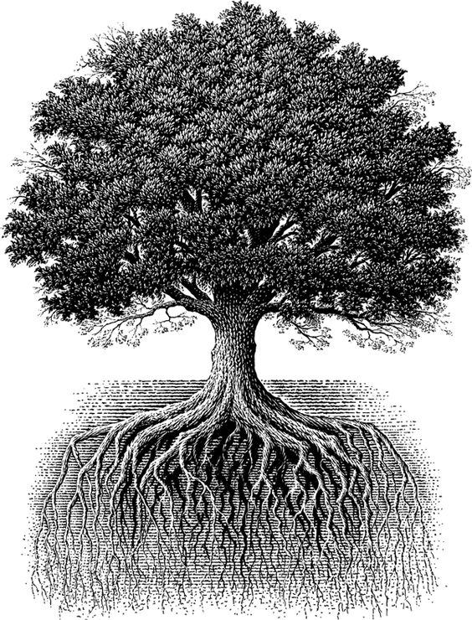
The Tree of Corporate Storytelling
Story-telling and Story-listening
Content Management
Structure of Stories
Branding in Practice
Sense-making

Slide 4
Objective
reality
Subjective
reality
Abstraction
(Fiction)

Slide 5
The Rise of Fiction
Year | 70.000 | 5.000 | 4.000-1500bc | 700bc | 1455 | 1991
Era | Cognitive Revolution | Agricultural Revolution | Writing + Money (Sumerians, Egyptians) | Holistic Narratives (myths) | Printing -Johannes Gutenberg | World Wide Web - Tim Berners Lee
Type of Stories | Local stories of spirits and ghosts | Intersubjective stories of gods | Stories of living deities (brands) | Universal stories of gods, and humans against gods (hybris) | Universal written stories | The world web of stories constantly (re)create History
Audience | Nomads (tribes) | Settled (tribes of tens) | Cities (thousands) | Kingdoms (hundred thousands) | World (millions) | Ubiquity (billions)
Brands | Spirits | Local gods and heroes | Pharaons | Ulysses | Bible | You

Slide 6
Maslow’s Hierarchy of Needs
Self
Actualization
Esteem
Belonging
Safety
Physiological

Slide 7
Motivational theory + Archetypal theory
I need to feel safe, have a home, wake up at the same time every morning!
Stability
I need my friends and my family, I need to love and be loved
I need my own time and space, I want to travel and explore the world, leave me alone!
Belonging
Independence
Mastery
I need to risk! Change my life, quit my job, say no to things a don’t want!

Slide 8
Archetypes mediate between products and customer motivation by providing an intangible experience of meaning (p.17)

Slide 9
Creator
Caregiver
Ruler
Lover
Innocent
Stability
Regular Guy
Belonging
Independence
Explorer
Mastery
Jester
Sage
Hero
Outlaw
Magician

Slide 10
Each archetype responds to a specific plot. And great plots are archetypical too.

Slide 11
Darwininan natural selection of stories
Stories are like giraffes! Only the stories that resonate with us survive!

Slide 12
Before the invention of writing, stories were passed down from generation to generation as campfire, ghost, and bedtime stories.
Darwininan natural selection of stories
Over time, as stories were told, memorized and retold, certain stories, ideas, themes, characters, and situations would resonate deeply with listeners and would be saved. Other story details would be found lacking and would be tossed aside.
The enduring, distilled stories become the universally ‘truthful’ fairy tales, legends and mythological stories that have come down to us today. (p.289)

Slide 13
Stability
Plot Archetypes
Paradise
(almost)
lost
Paradise
visited
Foundling
stories
Ugly
duckling
Redemption
Belonging
Independence
[TRANSFORMATIONS]
Wandering
angel
Journey
Paradise
found
Mastery

Slide 14
Stability
Hero unsatisfied reaches for the forbidden fruit and, as a result, loses all good that he had
(Adam & Eve, Dr. Faust)
[Pact with the devil Archetype; the Warning Archetype]
Paradise
(almost)
lost
Hero has a taste of Paradise (innocence) but then has to return to the ordinary world
(the wish of the Ruler to be Innocent for a moment)
e.g. high end travel industry
Paradise
visited
Belonging
Independence
Mastery

Slide 15
Hero is weak and feels lonely. Finds a creature that’s even weaker and becomes its protector. Thus he feels stronger. Communicates magically with the creature. Rescue the creature, that goes back to its home
(E.T., Stranger Things…)
Stability
Hero as an outlaw finds Innocence through the experience of Paradise
(e.g. A Christmas Carol)
Foundling
stories
Ugly
duckling
Redemption
Belonging
Independence
[TRANSFORMATIONS]
Hero has hidden virtues but is in stasis and has no plan. A mentor suspects about his virtues. The Hero “changes costumes” and is self-aware of his potentials. Hero struggles. Happy ending.
(Cinderella, Elephant Man, Pretty Woman, Superman…)
Mastery

Slide 16
Stability
Belonging
Independence
Wandering
angel
a mentor helps the hero to make a transition from one stage to the next in the process of maturation and self-development
(e.g. Jerry McGuire, Road to Perdition)
Mastery

Slide 17
Stability
Hero called, refuse, journey starts, road of trials, meeting the goddess, return transformed
(Odyssey, Star Wars, Lord of the Rings)
Belonging
Independence
Journey
Hero in stasis, touches Paradise, back to ordinary world, struggle to go back to Paradise, change in life so that it is impossible to go back to the ordinary world. Hero stays in Paradise
(stories of change for a more fulfilling life)
Paradise
found
Mastery

Slide 18
Which psychological need for which story?
Motivational Need | Message | Plot archetype
Safety / Belonging | Appreciate your world and your place in it | Paradise (almost) lost Paradise visited
Mastery / Independence (wish for) | Maturation and growth are difficult, but achievable; you have it within yourself to change | Redemption stories Foundling stories Ugly Duckling
Mastery / Independence (realizing) | If you have the courage to grow, you can achieve true happiness in this life | Journey Paradise found
Mastery / Belonging | Your spirit is ready for a change but a mentor is needed | Wandering angel

Slide 19
Story Analysis
Story stages | Introduction | Characters | Problem | Peripeteia | Climax | Resolution | Rite de Sortie | Plot Archetype
 | Time and place (illud tempus). Where is the story set? When? | Psychological interpretation (who are they? How many?) symbolism of numbers; roles of characters. | What is the problem, the conflict? The story starts here | Rising actions (how many?) Into the extra-ordinary world | Highest degree of tension. The problem is solved | Back to the ordinary world. Happy ending or tragedy? | What is the universal archetype? Once you found the archetype, you can interpret the moral of the story. Is there a payoff? | Where does the plot fit in?
Amplify: widen a theme to find parallel versions. What are the parallel motives? Find the archetype!

Slide 20
Story Analysis
Story stages | Introduction | Characters | Problem | Peripeteia | Climax | Resolution | Rite de Sortie | Plot Archetype
Apple -Homepod
KPN - evert45.com
84 Lumber - The Journey
Red Cross - Hope https://youtu.be/A93_uVTYYA4
The tale of Thomas Burberry

Slide 21
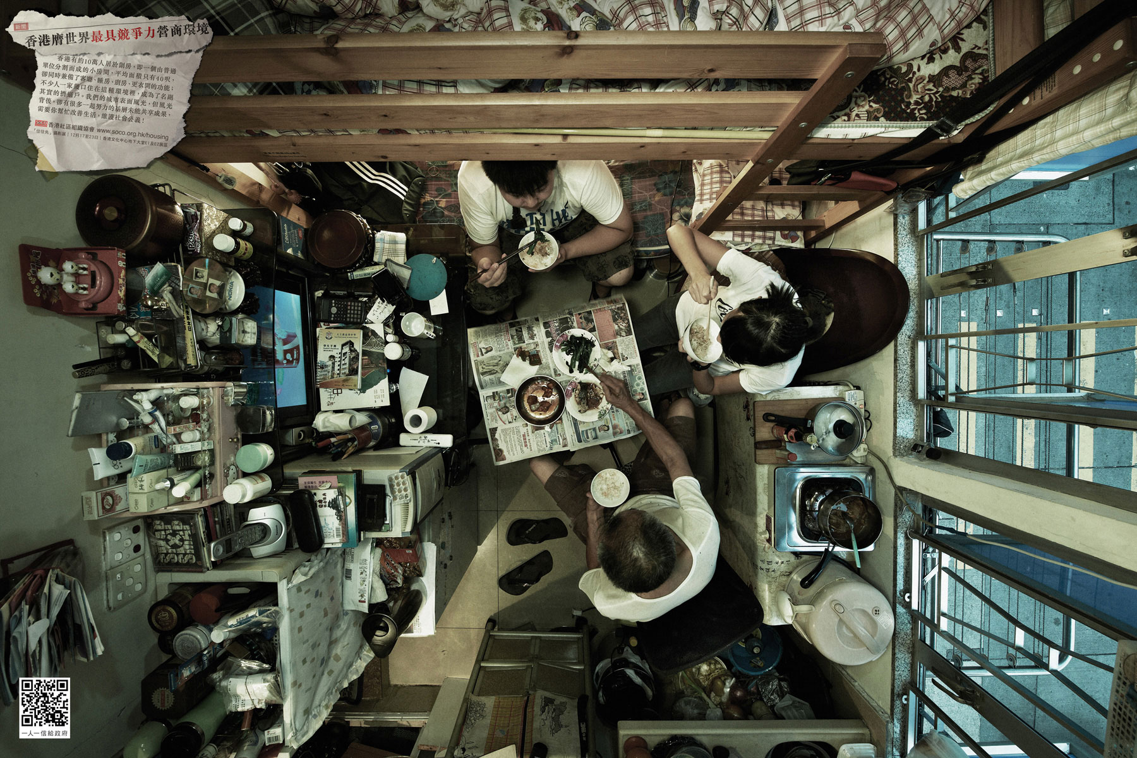

Slide 22
MEDIA ECOLOGY

Slide 23
ZEITGEIST

Slide 24


Slide 25
FRAGMENTS

Slide 26
AUTHENTICITY & FLUENCY

Slide 27
PERSONAL NARRATIVES

Slide 28
A Tale of Two Stories
When, in your life or in business, did you act differently than what your values say? When you felt pressure to act differently than your own values.
1: what did you do and what happened? what was the impact?
2: what motivated you to speak up and act?
3: how satisfied are you? is there something you would have done differently?
4: what made it easier for you to speak and act? (the Enablers) and what made it hard (the Disablers)

Slide 29
Trends
The quality of your life depends on the quality of the messages you are exposed to (Chuck Palaniuk). Communication professionals have to create a good media ecology in order to speak with their audience. Changing Perspective https://youtu.be/iN6g2mr0p3Q
Media Ecology
Environment
Brands convey environmental values. Dialogue is consistent with different stakeholders, who are always connected. Brands perceive reality and try to make a sense of it going beyond products and services. Patagonia https://eu.patagonia.com/it/it/artifishal.html
The difference between manpower and womanpower has become unsustainable. Communication have to be authentic, avoiding the so-called pink-washing. Like a girl https://youtu.be/XjJQBjWYDTs
#metoo
Data: the ‘oil of the XXI Century’. Protecting the users data has grown to be foundamental. Users and consumers are afraid of the use of their information. Companies have this responsibility. Cambridge Analytica https://youtu.be/Q91nvbJSmS4
Privacy
The trust of people towards media and institution has decreased. Social networks have become the ‘echo room’ for increasing fake news. Companies have to regain control of information. False news https://youtu.be/cSKGa_7XJkg
Fake News
Companies have to make a choice. Either you stay on one side of the river (activism, feminism, diversity, environmental issues etc) or the other side, that is just silence, and that is not an option anymore. Parks https://www.parksdiversity.eu
Choice

Slide 30
MEDIA ECOLOGY
The quality of your life depends on the quality of the messages you are exposed to (Chuck Palaniuk). Communication professionals have to create a good media ecology in order to speak with their audience. Changing Perspective https://youtu.be/iN6g2mr0p3Q
Apple turn experiences into stories https://youtu.be/M-1GPznHrrM
Xbox turn consumers into designers https://youtu.be/PwT4Bj1KLSA

Slide 31
ENVIRONMENT
Brands convey environmental values. Dialogue is consistent with different stakeholders, who are always connected. Brands perceive reality and try to make a sense of it going beyond products and services
Patagonia https://eu.patagonia.com/it/it/artifishal.html
Sixtinction http://sixtinction.net
Unilever 10river10ocean Alex Bellini
Adidas x Parley https://www.adidas.it/parley

Slide 32
#METOO
The difference between manpower and womanpower has become unsustainable. Communication have to be authentic, avoiding the so-called pink-washing.
Like a girl https://youtu.be/XjJQBjWYDTs
NASA women spacewalk cancelled https://www.theguardian.com/science/2019/mar/25/nasa-all-female-spacewalk-canceled-women-spacesuits
DOVE Campaign for real beauty
NIKE Serena Williams https://www.nike.com/it/launch/t/serena-williams-unlimited-greatness/

Slide 33
PRIVACY
Cambridge Analytica https://youtu.be/Q91nvbJSmS4
Facebook ‘the future is provate’ https://www.theverge.com/2019/4/30/18524188/facebook-f8-keynote-mark-zuckerberg-privacy-future-2019

Slide 34
FAKE NEWS
The trust of people towards media and institution has decreased. Social networks have become the ‘echo room’ for increasing fake news. Companies have to regain control of information. False news https://youtu.be/cSKGa_7XJkg

Slide 35
MAKE A CHOICE
Companies have to make a choice. Either you stay on one side of the river (activism, feminism, diversity, environmental issues etc) or the other side, that is just silence, and that is not an option anymore.
Parks https://www.parksdiversity.eu
P&J The Talk https://youtu.be/3s20ePvTaME

