Slide 1
Storytelling:
the Archetypes
Lessons #7

Slide 2
Objectives of the lesson:
Understand the relevance of the Jung’s archetypes for business
Define the 12 archetypes to build a powerful brand
- How to analyze a story as a fairy-tale
M. Mark, C. S. Pearson, The Hero and the Outlaw, 2001, McGraw-Hill
pages: 1-47
pages: 263-375

Slide 3
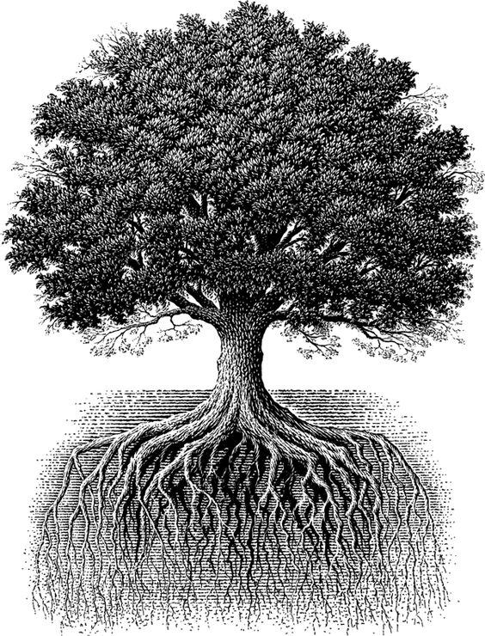
The Tree of Corporate Storytelling
Story-telling and Story-listening
Content Management
Structure of Stories
Branding in Practice
Sense-making

Slide 4
“All that happens is symbol”
Goethe, 1818

Slide 5
Brands and products grab and keep our attention because they embody an archetype
Meaning is a brand asset. Either you lower your price or you imbue your products with meaning.
Archetypical psychology help us understand the intrinsic meaning of product categories and help marketers create enduring brand identities that establish market dominance, evoke and deliver meaning to customers, and inspire customer loyalty (p.12)
Products serve as a mediating function between a need and its fulfillment

Slide 6
Maslow’s Hierarchy of Needs
Self
Actualization
Esteem
Belonging
Safety
Physiological

Slide 7
Motivational theory + Archetypal theory
I need to feel safe, have a home, wake up at the same time every morning!
Stability
I need my friends and my family, I need to love and be loved
I need my own time and space, I want to travel and explore the world, leave me alone!
Belonging
Independence
Mastery
I need to risk! Change my life, quit my job, say no to things a don’t want!

Slide 8
Archetypes mediate between products and customer motivation by providing an intangible experience of meaning (p.17)

Slide 9
Creator
Caregiver
Ruler
Lover
Innocent
Stability
Regular Guy
Belonging
Independence
Explorer
Mastery
Jester
Sage
Hero
Outlaw
Magician

Slide 10



Independence
Innocent
Brands
The innocent brand wants to experience paradise here on earth. He wants to be happy, easy, laid-back. He does things right, has faith and optimisms. Consumers believe in a pure, joyful society where things will always have a happy ending. Messages might be naive, pure, provide simple answers to simple problems. The innocent has a high morality. Products are usually low priced.
Example
https://youtu.be/c3gPZ3U4sJw

Slide 11



Independence
Explorer
Brands
The explorer brand wants to explore the world to find out who and what it really is. It yearns for paradise and it goes to look for it because it doesn’t know where to find it. Explorers wants to experience a more authentic and fulfilling life. They are wanderers, individualists, likes to travel, wants to feel free. Loves nature and the road, is often anti conformist but not in rebellious terms.
Example
https://youtu.be/4IyTXRfnYmQ

Slide 12

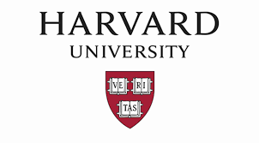

Independence
Sage
Brands
The sage brands wants to find the truth using intelligence to understand the world. Universities are great Sage brands. The gift of the Sage is wisdom.IT fights dogmatism and disconnection from reality. They are experts, scholars, thinker, serious about what they offer, hardly funny or making jokes. The Sage consumer wants to rely on the brands a source of knowledge. The brands reveal new scientific breakthrough supported by hard data.
Example
https://youtu.be/K7VhW8DQ_Bs

Slide 13



Mastery
Hero
Brands
The Hero brand wants to achieve something never achieved before, has power and energy, wants to change the world through risking its life. The Hero takes great risks and develop competences in order to contribute to the society. They are culturally transformative figures, they prove one’s worth through courageous and difficult actions, is inspirational for others. The Hero brand is the superhero you want to become. It helps you become as strong and skillful as you can be. Oedipus is a hero brand.
Example
https://youtu.be/WYP9AGtLvRg

Slide 14



Mastery
Outlaw
Brands
The more well behaved and responsible you are, the more you yearn to be an outlaw, at least a little bit, some of the time, maybe through an outlaw product or service. While the hero wants to be admired, the outlaw is satisfied to be feared. The outlaw brands convey meanings of shadows and forbidden behaviors. They love to be identified with things that are bad for you. They have energy, anger, want to die to reborn. It’s your wild side.
Example
https://youtu.be/vLj_HU4qXdw

Slide 15



Mastery
Magician
Brands
The Magician brand desires to search out the fundamental laws of how things work and to apply these principles to getting things done. It invents products that make things happen. Magicians foster “magical moments” (sparkling water, champagne, many cruise lines, spas, chic hotels, exotic travels, miracle drugs). Entrepreneurs and athletes are often Magicians. Products is transformative, they convey implicit promises of transformation. They are medium or high priced. They might have a spiritual or strong psychological component.
Example
https://youtu.be/BLAnTQfFXOI

Slide 16


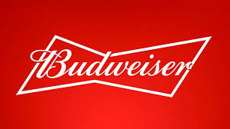
Belonging
Regular Guy
Brands
The Regular Guy brand desires to connect, to fit in, to be part of a group or a society. It demonstrates the virtues of simply being an ordinary persona, just like others. that’s the everyday person, no fuzz, just regular. The underlying value is that everyone matters, just as they are. Good things of life belong to everyone, not just to elites. Consumers desire not to be special or different in any way, but simply to melt into the packAnd once the yearning is satisfied, the tendency is simply to revel in the calm reassurance of ordinariness.
Example
https://youtu.be/SSzoDPptYNA

Slide 17

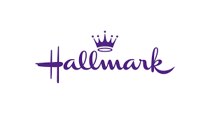

Belonging
Lover
Brands
The Lover desires to attain intimacy and experience sensual pleasure. Usually Lover brands are to be found in the cosmetic, jewelry, fashion and travel industries. This is the realm of hearts and flowers, love, long strolls on sunset beaches, dancing in the moonlight. Lovers want to attract, give love, express affection in intimate and pleasurable ways. the Lover fears not being loved, that’s why it always engages in self-improvement projects to be ever more worthy of attention. The connection is deep, the story is a love (friendship) narrative.
Example
https://youtu.be/v61wTya_GJY

Slide 18
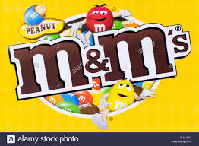
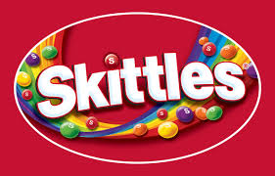

Belonging
Jester
Brands
The Jester calls us to come out and play with one another. The places are where fun can be found: almost anywhere. The Jester lives in the moment with full enjoyment, it deals with the absurdities of the modern world and with faceless, amorphous present-day bureaucracies. Its willingness to break rules leads to innovative, out-of-the-box thinking.It is afraid of boredom and seriousness.It is the fool in the King’s court, revealing the truths (through jokes) that no one else reveals.The Jester conveys the value of here-and-now. Colors are bright and a lot of action happens. It let us live in the present. Product prices are low.
Example
https://youtu.be/_PtOAnZxB8s
https://youtu.be/ZbJO00yvAk0

Slide 19



Stability
Caregiver
Brands
The Caregiver is an altruist, a powerful maternal figure. It is the nurse, the old-fashion country doctor, the teacher, the neighbourhood cop. The Caregiver wants to protect others from harm, help them, do things for others. As opposite to the Lover, it has ceased to be the center of its own universe. It is able to balance self-care with care for others. Insurance, banks, medical care, financial planning fit into this category. The Caregiver is empathic, listens, is reliable, is a protector, you can trust on the Caregiver. For companies, customer service is a caregiver activity. Many NGOs use Caregive narratives.
Example
https://youtu.be/xkF4X5MfW0w

Slide 20


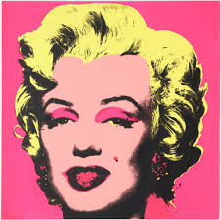
Stability
Creator
Brands
The Creator’s passion is self-expression in material form. It is not about fitting in, but about self-expression. Authenticity is extremely essential, the imagination is power.Every Creator knows that structures determine outcomes.It needs its freedom (like the Innocent, Explorer, Sage).Creation also means re-creation: education, fitness, beauty. The Creator forms its own vision, it creates structures that influence culture and society. Creator organizations want not just to appear as a work of art, but to embody one. Fields are: marketing, PR, the arts, technological innovations where self-expression is encouraged.
Example
https://youtu.be/BfhV3Q4LJPM

Slide 21

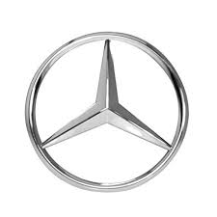

Stability
Ruler
Brands
The Ruler wants to control, to create something structured, prosperous, invincible. It is the leader of the market, it fears chaos, it is responsible and trustworthy. It is the new royalty, wealthy, classy. It has no fear of innovation because it is in control of the situation and the environment. Products are reliable and give status, they help people being more organized and powerful. the price is moderate to high. The brand seeks to differentiate from a populist one (Regular Guy). The Ruler promises safety and predicability in a chaotic world.
Example
https://youtu.be/HAGY_N4dE3Y

Slide 22
Each archetype responds to a specific plot. And great plots are archetypical too.

Slide 23
Stability
Plot Archetypes
Paradise
(almost)
lost
Paradise
visited
Foundling
stories
Ugly
duckling
Redemption
Belonging
Independence
[TRANSFORMATIONS]
Wandering
angel
Journey
Paradise
found
Mastery

Slide 24
Stability
Paradise
(almost)
lost
Hero unsatisfied reaches for the forbidden fruit and, as a result, loses all good that he had (Adam & Eve, Dr. Faust)
Paradise
visited
Hero has a taste of Paradise (innocence) but then has to return to the ordinary world (the wish of the Ruler to become the Innocent)
e.g. high end travel industry
Belonging
Independence
Mastery

Slide 25
Hero is weak and feels lonely. Finds a creature that’s even weaker and becomes its protector. Thus he feels stronger. Communicates magically with the creature. Rescue the creature, that goes back to its home (E.T., Stranger Things…)
Stability
Hero as an outlaw finds Innocence through the experience of Paradise (e.g. A Christmas Carol)
Foundling
stories
Ugly
duckling
Redemption
Belonging
Independence
[TRANSFORMATIONS]
Hero has hidden virtues but is in stasis and has no plan. A mentor suspects about his virtues. The Hero “changes costumes” and is self-aware of his potentials. Hero struggles. Happy ending. (Cinderella, Elephant Man, Pretty Woman, Superman…)
Mastery

Slide 26
Stability
Belonging
Independence
Wandering
angel
a mentor helps the hero to make a transition from one stage to the next in the process of maturation and self-development (e.g. Jerry McGuire, Road to Perdition)
Mastery

Slide 27
Stability
Hero called, reuse, journey starts, road of trials, meeting the goddess, return transformed
(Odyssey, Star Wars, Lord of the Rings)
Belonging
Independence
Journey
Hero in stasis, touches Paradise, back to ordinary world, struggle to go back to Paradise, change in life so that it is impossible to go back to the ordinary world. Hero stays in Paradise (stories of change for a more fulfilling life)
Paradise
found
Mastery

Slide 28
Which psychological need for which story?
Motivational Need | Message | Plot archetype
Safety / Belonging | Appreciate your world and your place in it | Paradise (almost) lost Paradise visited
Mastery / Independence (wish for) | Maturation and growth are difficult, but achievable; you have it within yourself to change | Redemption stories Foundling stories Ugly Duckling
Mastery / Independence (realizing) | If you have the courage to grow, you can achieve true happiness in this life | Journey Paradise found
Mastery / Belonging | Your spirit is ready for a change but a mentor is needed | Wandering angel

Slide 29
Story Analysis
Story stages | Introduction | Characters | Problem | Peripeteia | Climax | Resolution | Rite de Sortie | Plot Archetype
 | Time and place (illud tempus). Where is the story set? When? | Psychological interpretation (who are they? How many?) symbolism of numbers; roles of characters. | What is the problem, the conflict? The story starts here | Rising actions (how many?) Into the extra-ordinary world | Highest degree of tension. The problem is solved | Back to the ordinary world. Happy ending or tragedy? | What is the universal archetype? Once you found the archetype, you can interpret the moral of the story. Is there a payoff? | Where does the plot fit in?
Amplify: widen a theme to find parallel versions. What are the parallel motives? Find the archetype!

Slide 30
Story Analysis
Story stages | Introduction | Characters | Problem | Peripeteia | Climax | Resolution | Rite de Sortie | Plot Archetype
Apple -Homepod
KPN - evert45.com
84 Lumber - The Journey
Red Cross - Hope https://youtu.be/A93_uVTYYA4
The tale of Thomas Burberry

Slide 31
More ideas…
Turn experience into stories (Today at Apple)
https://youtu.be/M-1GPznHrrM
Brand activism (P&G The Talk)
https://youtu.be/3s20ePvTaME
Social & Influencer stories (Nike Nothing Beats a Londoner)
https://youtu.be/26qmJzTCRG4
Stories to let consumers
be part of the brand (Microsoft Xbox)
https://youtu.be/PwT4Bj1KLSA

