Slide 1
Storytelling:
the Monomyth
Lessons #5 & #6

Slide 2
Objectives of the lesson:
Understand the concept of J. Campbell “every story is the same story”
Define the Hero and the Monomyth
J. Campbell, The hero with a thousand faces, New world library, 2008 (pp. 1-37)

Slide 3
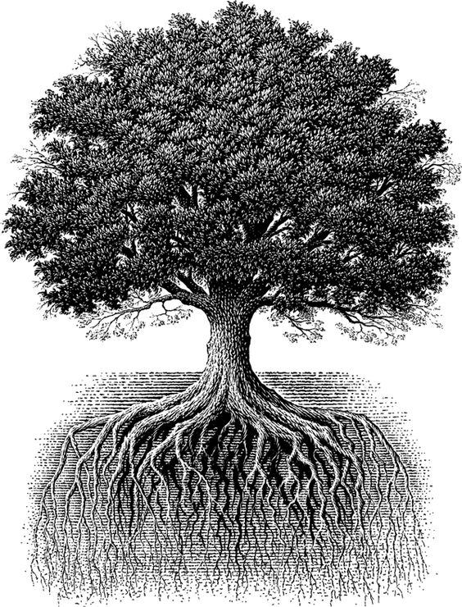
The Tree of Corporate Storytelling
Story-telling and Story-listening
Content Management
Structure of Stories
Branding in Practice
Sense-making

Slide 4
“…it will always be the one, shape-shifting yet marvelously constant story that we find,
together with a challengingly persistent suggestion of more remaining to be experienced that will ever be known or told.”
J. Campbell

Slide 5
“It would be not too much to say that myth is the secret opening through which the inexhaustible energies of the cosmos pour into the human cultural manifestation. (…)
They are not manufactured; they cannot be ordered, invented, or permanently suppressed. They are spontaneous productions of the psyche, and each bears within it, undamaged, the germ power of its source.”
J. Campbell

Slide 6
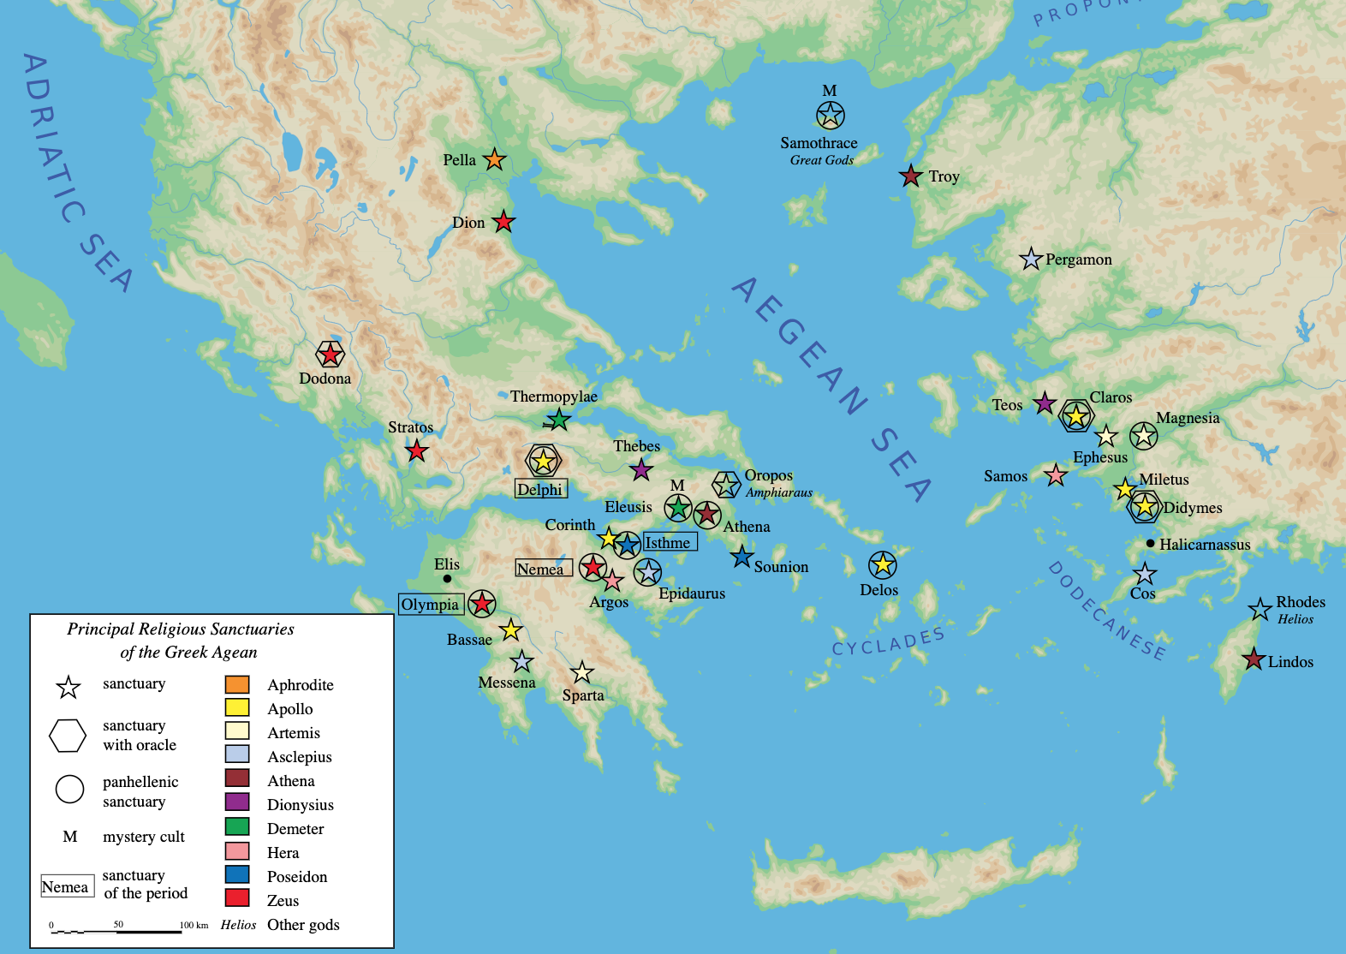

Slide 9
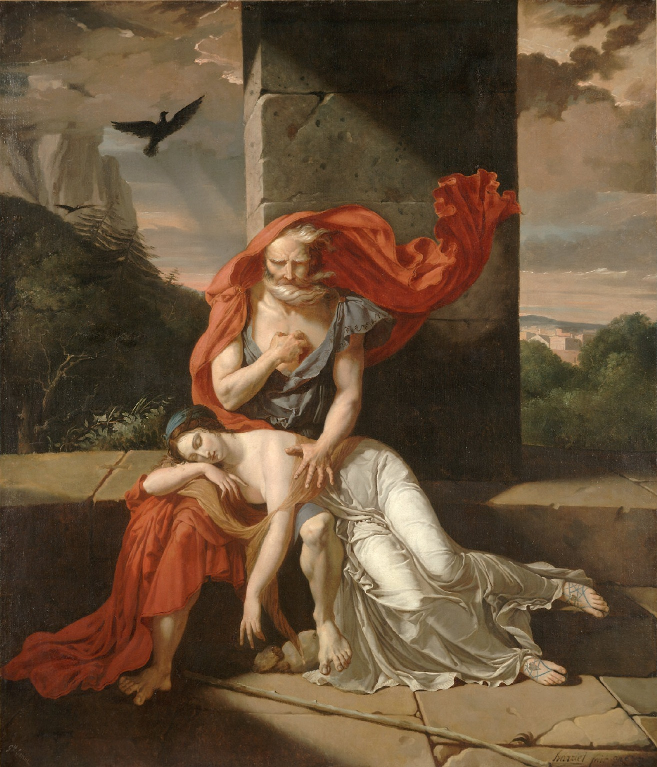
Oedipus at Colonus Fulchran-Jean Harriet
(1798)

Slide 10
“King Oedipus, who slew his father Laius and married his mother Jocasta, merely show us the fulfillment of our own childhood wishes.
But, more fortunate than he, we have meanwhile succeeded, in so far we have not become psychoneurotic, in detaching our sexual impulses from our mothers and in forgetting our jealousy of our fathers”
S. Freud

Slide 11
THE MONOMYTH

Slide 12
The first work of the HERO is to retreat from the world scene of secondary effects to the those causal zones of the psyche where the difficulties really reside, and there to clarify the difficulties, eradicate them in his own case and break through to the undistorted, direct experience and assimilation of what C. G. Jung has called “the archetypal images”
J. Campbell

Slide 13
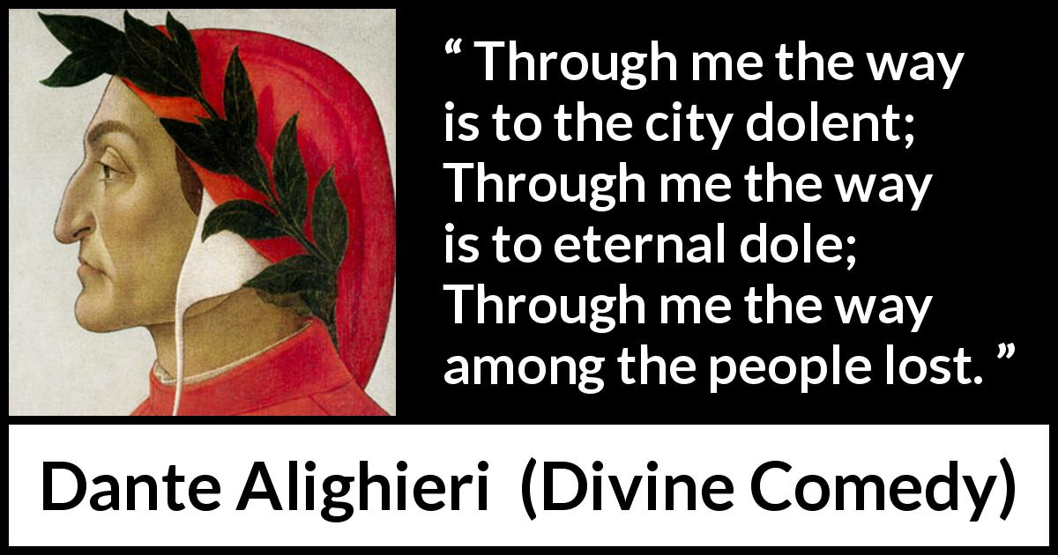

Slide 14
The hero’s second solemn task and deed therefore is to return to us, transfigured, and teach the lesson he has learned of life renewed.
J. Campbell

Slide 15
Rites of Passage
SEPARATION
a departure from the world
RETURN
a life-enhancing return
INITIATION
a penetration to some source of power
the nuclear unit of the Monomyth

Slide 16
Rites of Passage
RETURN
SEPARATION
INITIATION

Slide 17
The Monomyth
Freedom to Live
Call to Adventure
Master of Two Worlds
Crossing the Return Threshold
Refusal of the call
Rescue from Without
Supernatural Aid
Return
Separation
Magic Flight
Crossing the Threshold
Refusal of Return
Ordinary
World
Belly of the Whale
Extraordinary World
The Ultimate boon
Apotheosis
Initiation
Atonement with the Father
Road of Trials
Temptation
Meeting
with the
Goddess

Slide 18
The Monomyth
Stage I: Separation
Call to Adventure
The Hero starts off in a mundane situation of normality from which some information is received that acts as a call to head off into the unknown
Refusal of the Call
Often when the call is given, the future hero refuses to heed it. This may be from a sense of duty or obligation, fear, insecurity, inadequacy
Meeting the Mentor
Once the hero has committed to the quest, consciously or unconsciously, the mentor appears, or becomes known
The Hero leaves the known limits of his or her world and ventures into an unknown and dangerous realm where the rules and limits are not known
Crossing the Threshold
The final separation from the hero’s known world and self. The Hero shows his willingness to undergo a metamorphosis. He is swallowed by the unknown. To the outside world he might as well be dead
The Belly of the Whale

Slide 19
The Monomyth
Stage II: Initiation
A series of tests, tasks or ordeals that the Hero must undergo to begin the transformation. Often the Hero fails one or more fo these tests, which often occurs in three
Road of Trials
Meeting with the Goddess
The Hero experiences a Love that has the power and significance of the all-powerful, unconditional love (infant-mother: Oedipus)
Temptation
Material temptations that may lead the Hero to abandon or stray from his quest
Atonement with the Father
The Hero is confronted and must be initiated by whoever holds ultimate power in his life. In myths this is often the Father
Apotheosis
A character dies a physical death to live in spirit (he’s made divine) and moves to a state of divine knowledge, love, compassion and bliss
The Ultimate Boon
The Hero conquers his Elixir. All the previous steps serve to prepare and purify the Hero for this step

Slide 20
The Monomyth
Stage III: Return
Having found bliss and enlightenment in the Extraordinary world, the Hero refuses to return to the Ordinary world to bestow the boon onto his fellow man
Refusal of Return
The Magic Flight
The Hero escapes with the boon. Crossing this threshold to return can be as dangerous as it was to get into the Extraordinary world.
Rescue from Without
The Hero needs a powerful guide to bring him back to the ordinary life (the Hero has been wounded or weakened by the experience)
Crossing the Return Threshold
The final ordeal: retaining the wisdom gained on the quest; integrating the wisdom into a human life; sharing the wisdom with the rest of the world
Master of Two Worlds
Acheiving a balance between the Spiritual and the Material world
Freedom to Live
Mastery leads to freedom from the fear of death, which in turn is the Hero’s freedom to live

Slide 21
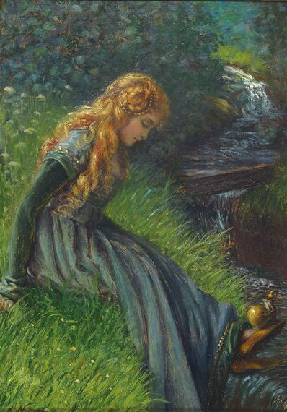
The Monomyth
Stage I: Separation
Call to Adventure
The Hero starts off in a mundane situation of normality from which some information is received that acts as a call to head off into the unknown
A blunder reveals an unsuspected world, and the individual is drawn into a relationship with forces that are not rightly understood (…) The blunder may amount to the opening of a destiny (p.42)
Freud: blunders are the result of suppressed desires and conflicts. They are ripples on the surface of life, produced by unsuspected things.
Destiny has summoned the hero and transferred his spiritual center of gravity from within the pale of his society to a zone unknown (p.48)
The Frog King, Grimm’s Fairy Tales nr.1 (///P.41)
The blunder is the disappearance of the golden ball.
The Frog is the Herald archetype.
The Spring (“so deep that the bottom could not be seen”) is the unknown, the unsuspected world
Emma Pastor Normann (The Frog King)

Slide 22
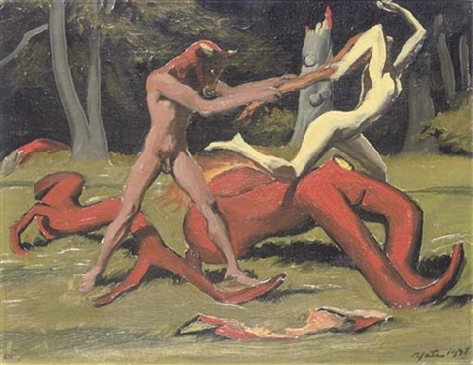
The Monomyth
Stage I: Separation
Refusal of the Call
The myths and folktales of the whole world make clear that the refusal is essentially a refusal to give up what one takes to be one’s own interest (p.49)
King Minos retained the divine bull, when the sacrifice would have signified submission to the will of the god of his society;
for he preferred what he conceived to be his economic advantage.
Thus he failed to avance into the life-role that he assumed.
Harold Yates, The Minotaur

Slide 23
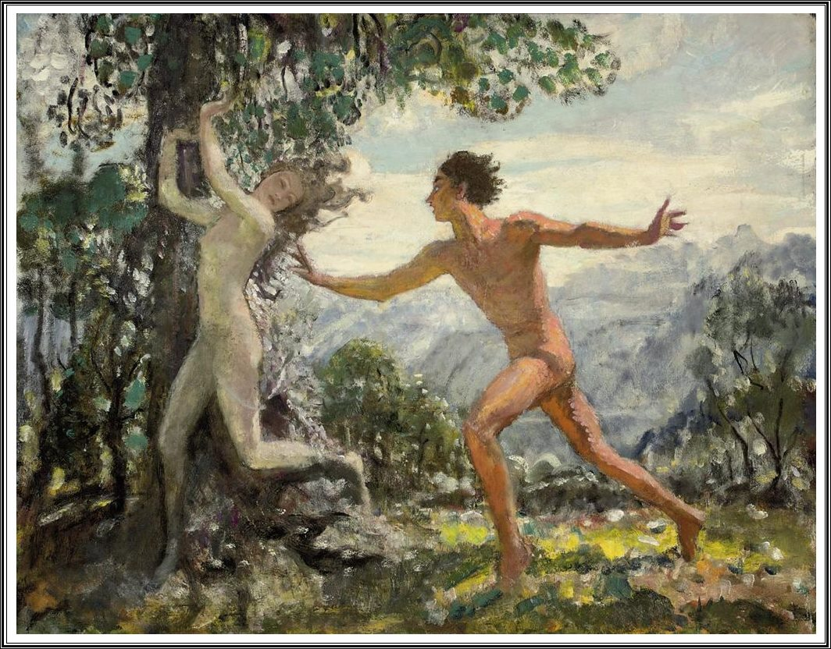
The Monomyth
Stage I: Separation
Refusal of the Call
Ovid, Metamorphoses, Apollon and Daphne “O nymph, O Peneus’ daughter, stay!”
if the personality is able to absorb and integrate the new forces, there will be experienced and almost super-human degree of self-consciousness and masterful control (p.53) = Yoga
George Watson, Apollon & Daphne

Slide 24
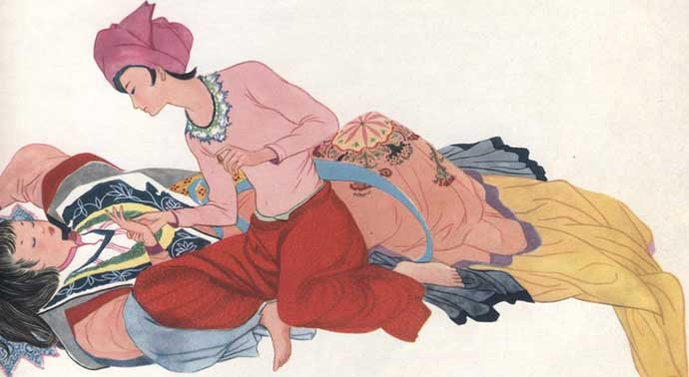
The Monomyth
Stage I: Separation
Refusal of the Call
O my father, she had answered, I have no mind to marry!
Budur and Kamar, Arabian Nights

Slide 25
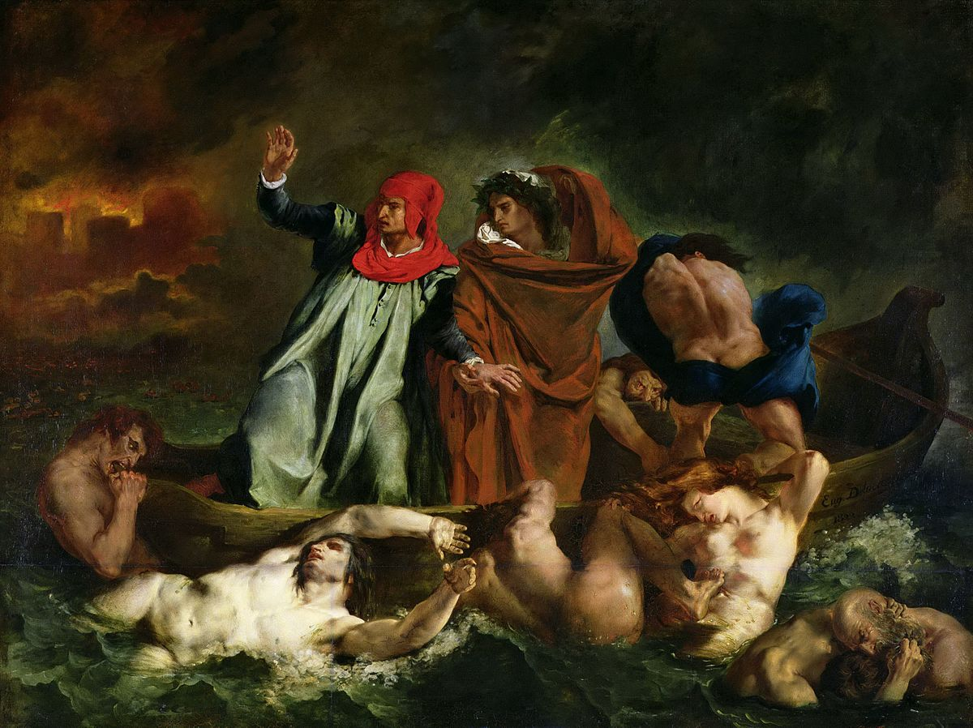
The Monomyth
Stage I: Separation
Supernatural Aid
For those who have not refused the call, the first encounter of the hero-journey is with a protective figure who provides the adventurer with amulets against the dragon forces he is about to pass (p.57)
What such a figure represents is the benign, protecting power of destiny (p.59)
Eugène Delacroix, The Barque of Dante, 1822

Slide 26
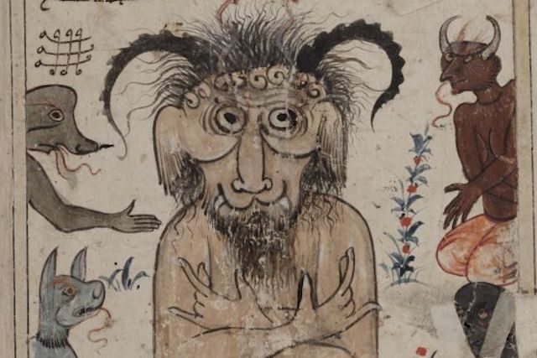
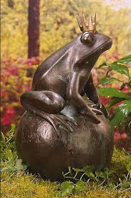
The Monomyth
Stage I: Separation
Supernatural Aid
Not infrequently the dangerous aspect of the “mercurial” figure is stressed; for he is the lurer of the innocent soul into realms of trials (p.60)
Jinn (Arabian Nights)
Frog King

Slide 27
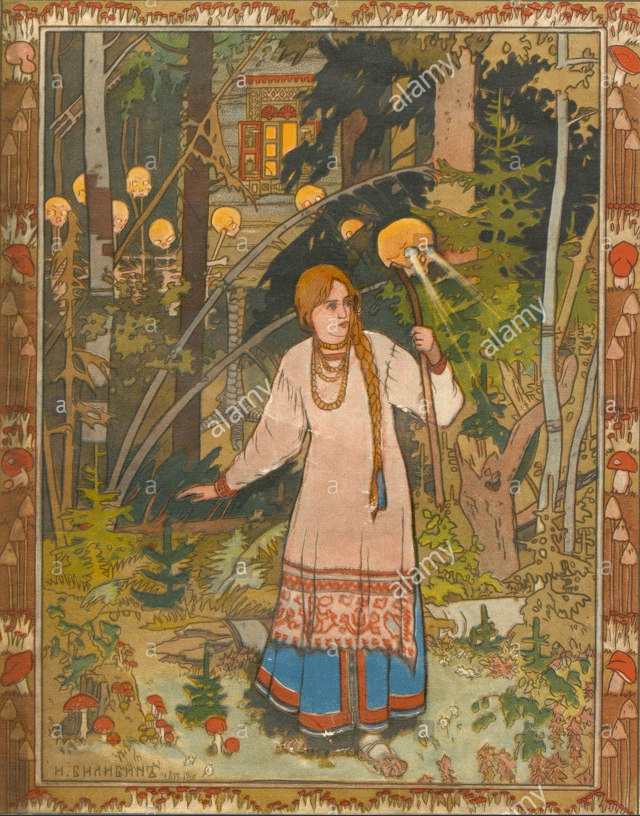
The Monomyth
Stage I: Separation
Crossing of the First Threshold
Beyond the guardian is darkness, the unknown, and danger. (…) The regions of the unknown are free fields for the projection of unconscious content (p64-65)
The adventure is always and everywhere a passage beyond the veil of the known into the unknown; the powers that watch at the boundary are dangerous; to deal with them is risky; yet for anyone with competence and courage the danger fades (p.67-68)
The passage of the magical threshold is a transit into a sphere of rebirth (p.74)
Ivan Bilibin, Vasilisa the Beautiful, 1899

Slide 28
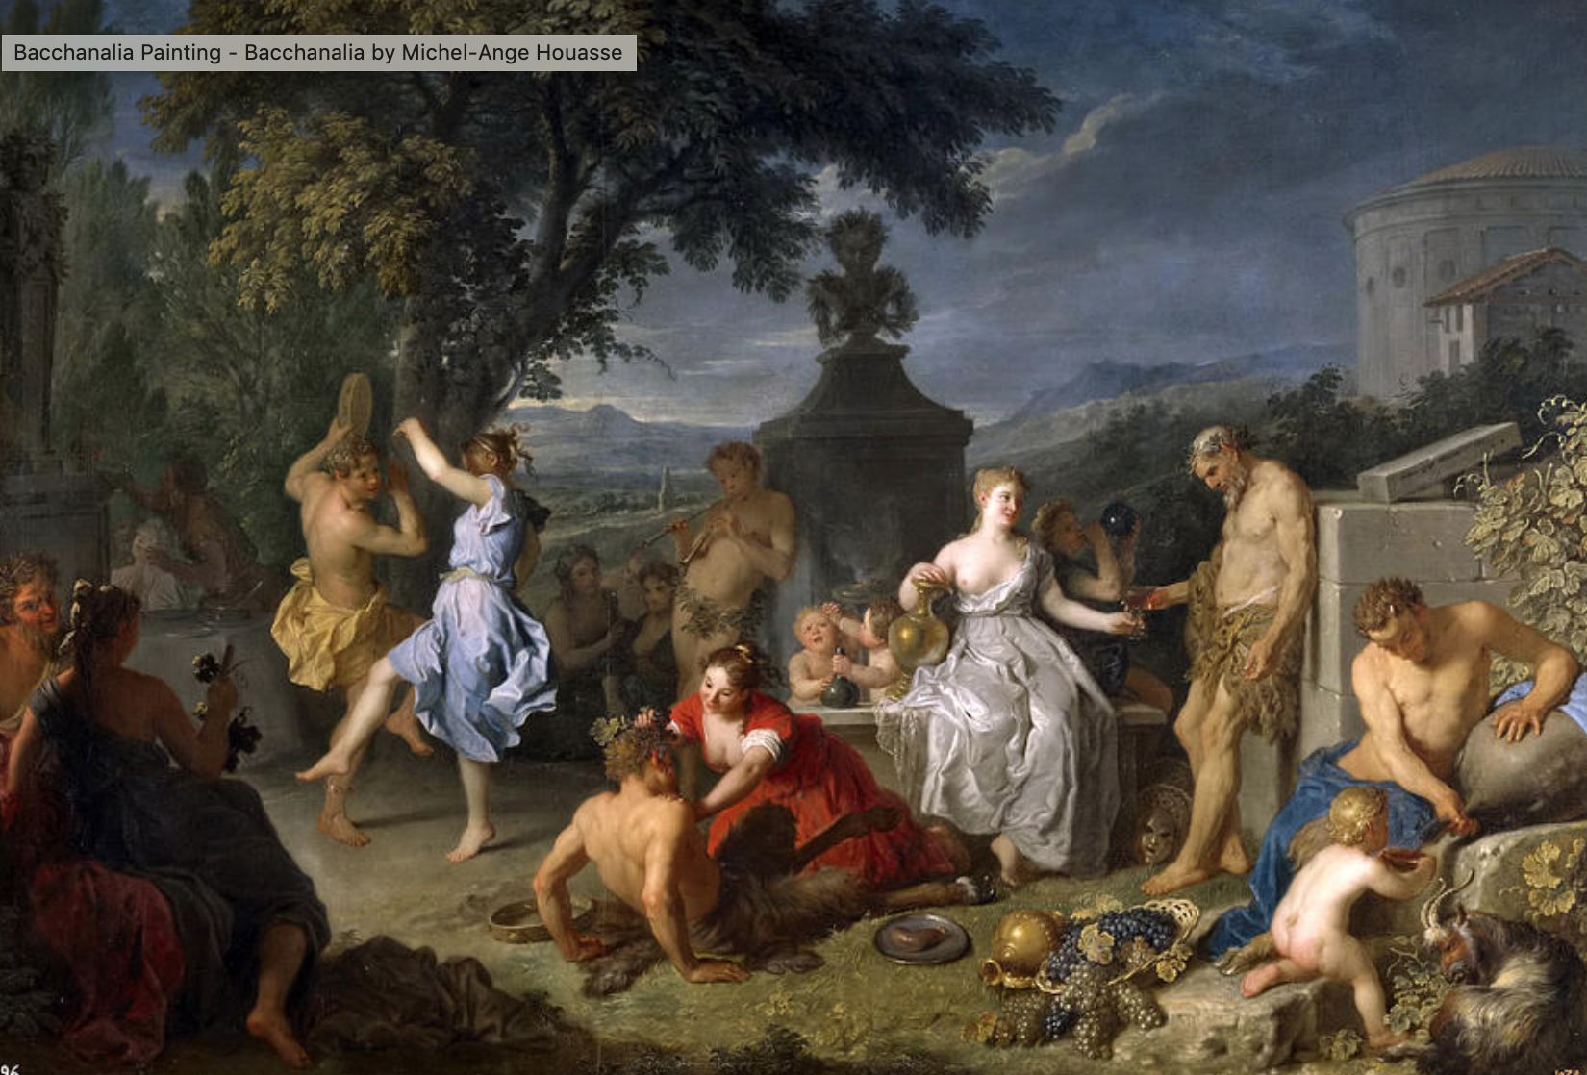
The Monomyth
Stage I: Separation
Crossing of the First Threshold
The Greek god Pan: the emotion that he instilled in human beings who by accident adventured into his domain was “panic” fear: a sudden, groundless fright (…) Pan was benign to those who paid him worship (p.66-67)
Michele-Ange Houasse, Bacchanalia

Slide 29
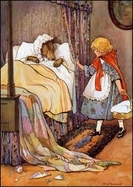
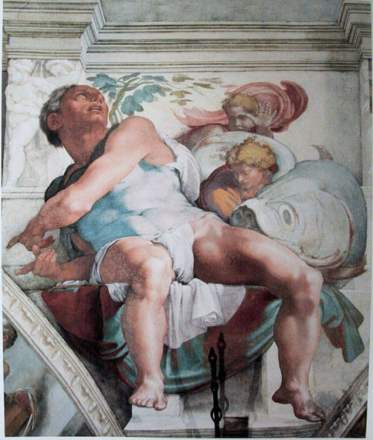
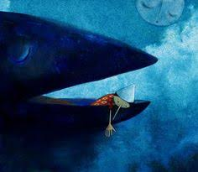
The Monomyth
Stage I: Separation
The Belly of the Whale
Michelangelo, Jonah, 1512
Pinocchio (Collodi, 1883)
Little Red Riding Hood (XVII century folktale)
The hero, instead of conquering or conciliating the power of the threshold, is swallowed into the unknown, and would appear to have died (p.74)
This popular motif gives emphasis to the lesson that that passage of the threshold is a form of self-annihilation (p.77)

Slide 30
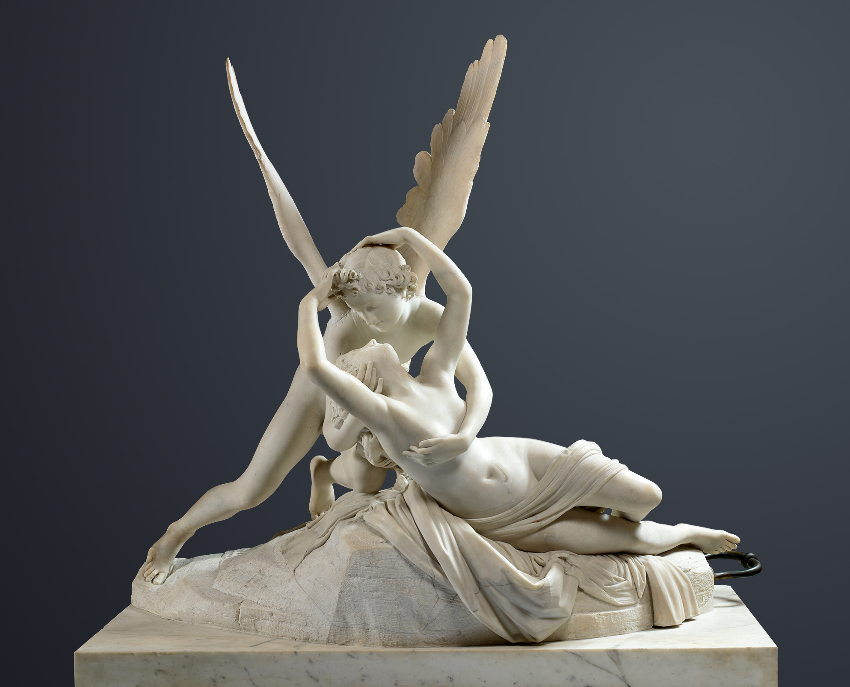
The Monomyth
Stage II: Initiation
The Road of Trials
The hero moves in a dream landscape of curiously fluid, ambiguous forms, where he must survive a succession of trials (p.81)
The hero is covertly aided by the advice, amulets, and secret agents of the supernatural helper whom he met before his entrance into this region (p.81)
“Or do you think that you shall enter the Garden of Bliss without such trials as came to those who passed away before you?”
Koran, 2:214
Antonio Canova, Cupid and Psyche, 1793

Slide 31
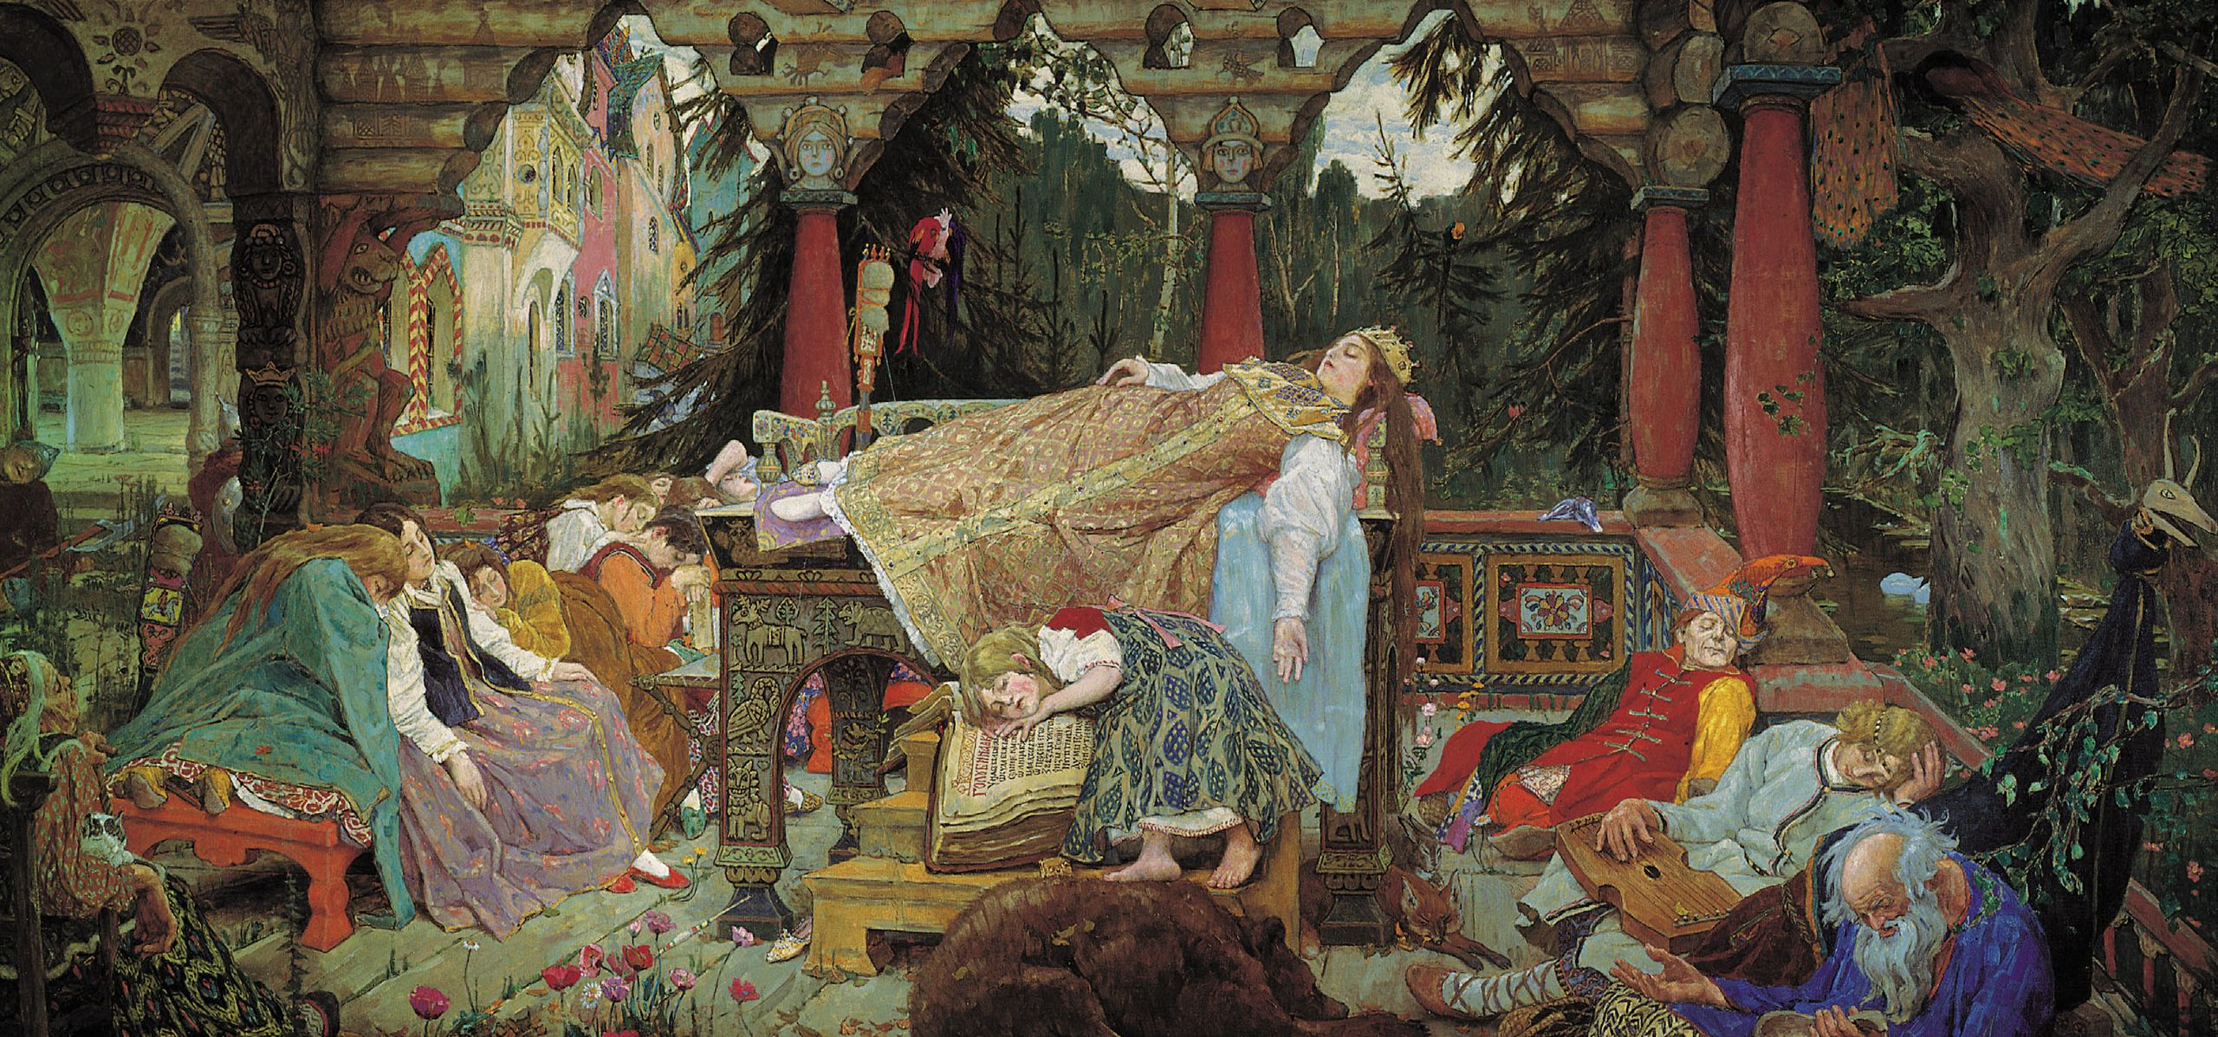
The Monomyth
When all barriers have been overcome, the ultimate adventure is commonly represented as a mystical marriage of the triumphant hero-soul with the Queen Goddess (p.91)
Stage II: Initiation
Meeting with the Goddess
The meeting with the goddess (who is incarnate in every woman) is the final test of the talent of the hero to win the boon of love, which is life itself enjoyed as the encasement of eternity (p.99)
Viktor Vasnetsov, The Sleeping Princess, 1926

Slide 32
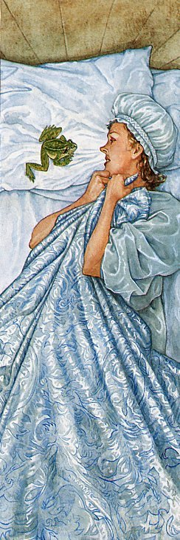
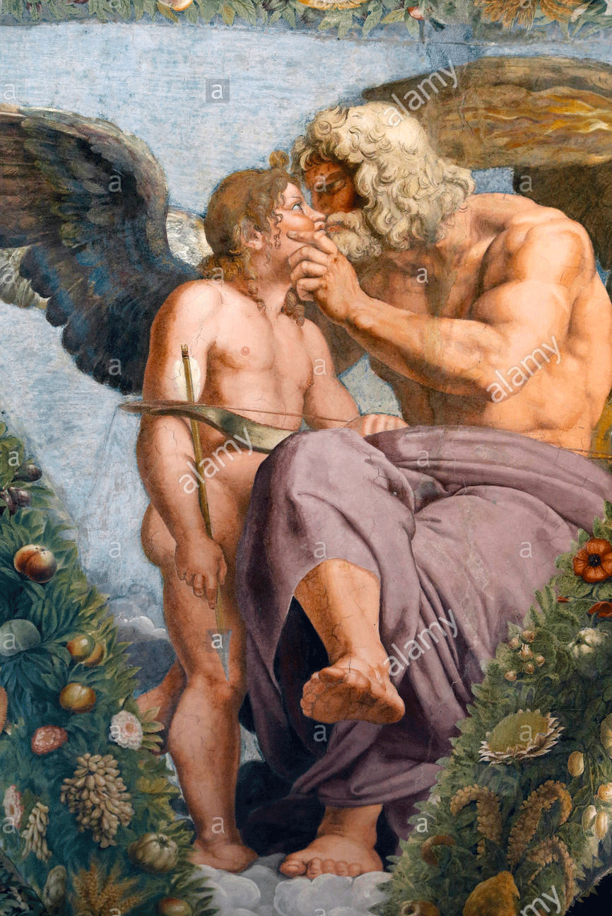
The Monomyth
Stage II: Initiation
Meeting with the Goddess
Woman, in the picture language of mythology, represents the totality of what can be known. The hero is the one who comes to know.
As he progresses in the slow initiation which is life, the form of the goddess undergoes for him a series of transfigurations: she can never be greater than himself, though she can always promise more than he is yet capable of comprehending.
She is redeemed by the eyes of understanding. The hero who can take her as she is (…) is potentially the king, the incarnate god, of her created world.
Psyche and Jupiter
And when the adventurer, she is the one who is fit to become the consort of an immortal (p.97)
The goddess has a similar role as the Mentor. But the hero is already on the journey. The goddess gives the hero more information or more powerful tools. The hero is directly involved.
Patrick James Lynch, The Prince Frog

Slide 33
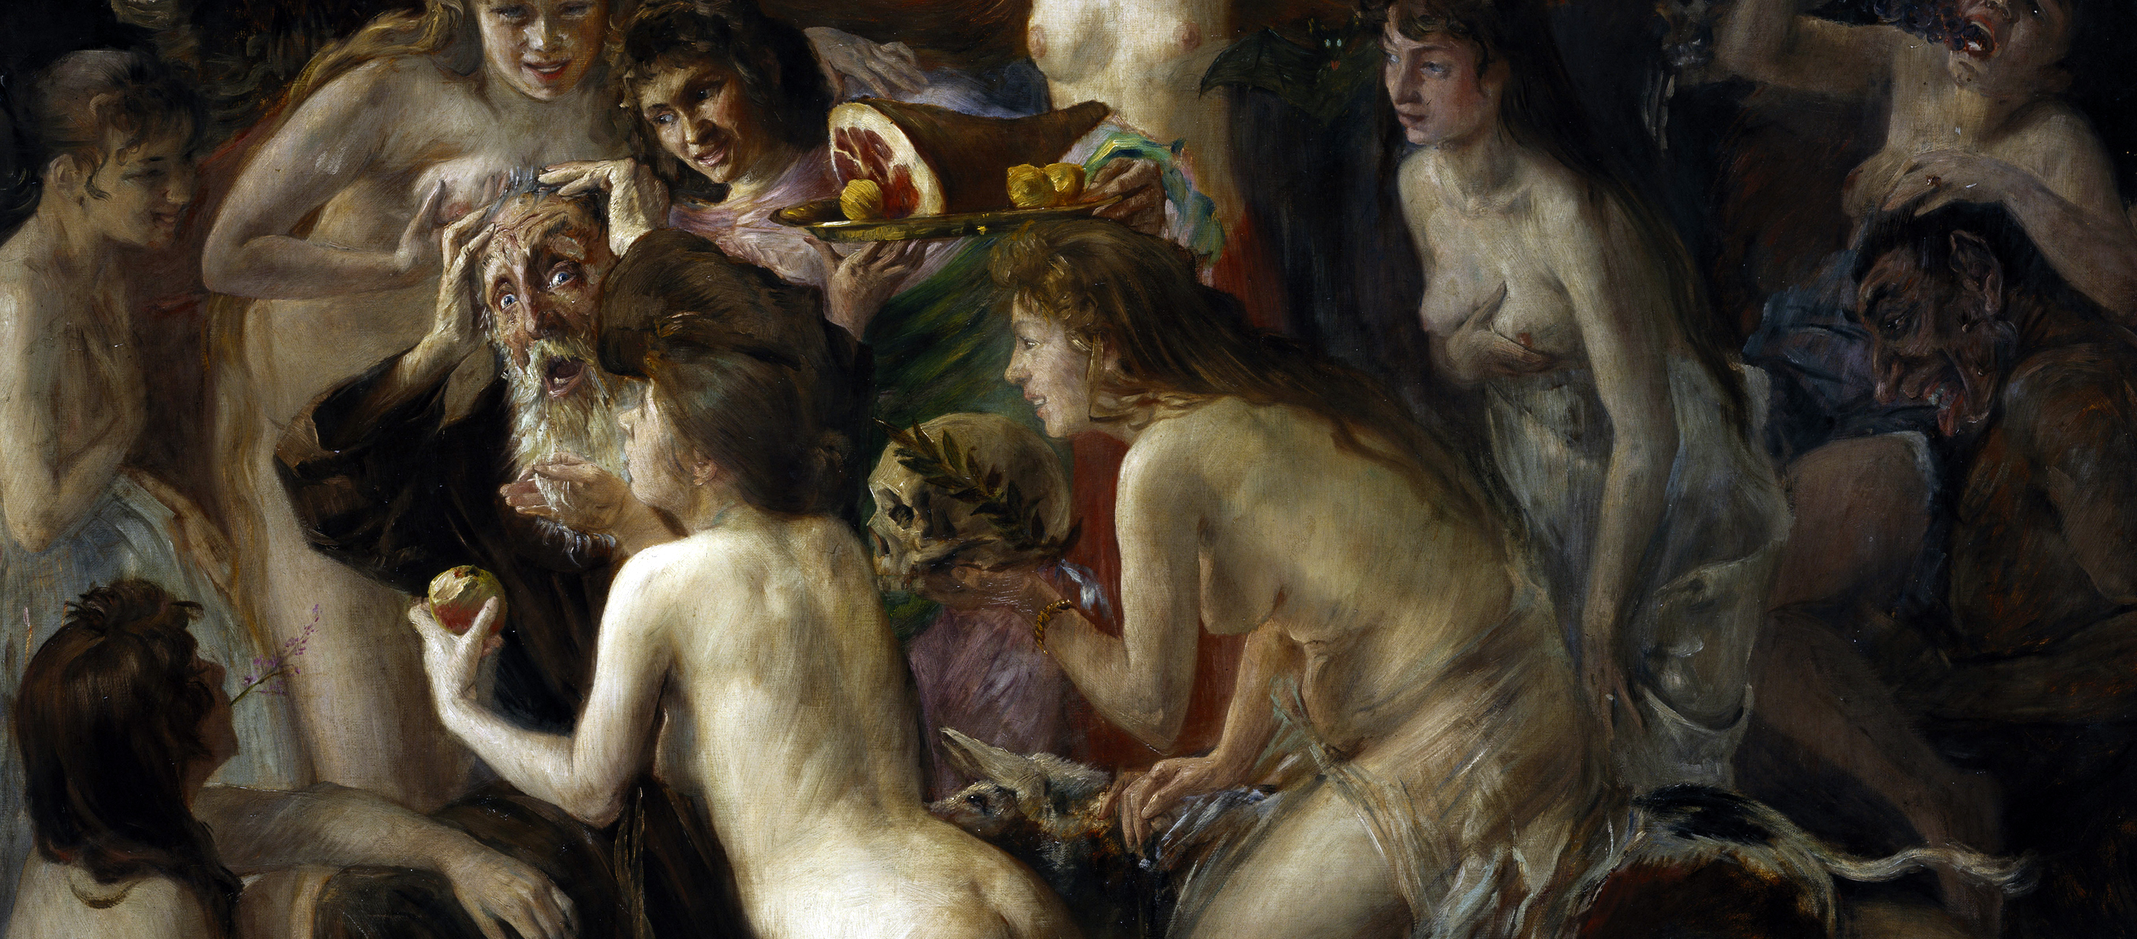
The Monomyth
Stage II: Initiation
Woman as the Temptress
Lovis Corinth, The temptation of Saint Anthony, 1897
The hero is tempted and challenged. The Goddess represents power (beautiful/ugly) and balance (masculine/feminine) and sends the hero into the approach to the cave in search of the boon.

Slide 34
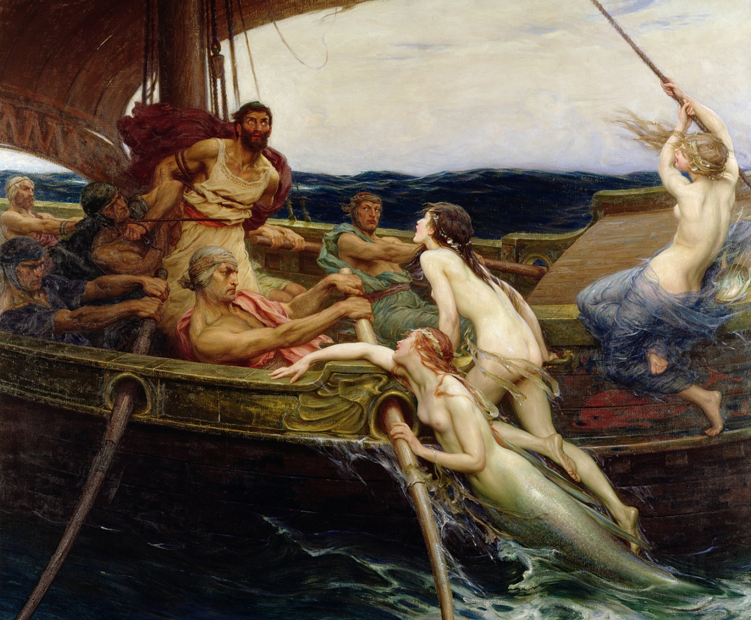
The Monomyth
Stage II: Initiation
Woman as the Temptress
While the Woman (male, female, thing…) represents the temptation to leave the journey revolving around the weaknesses of the hero; or persuading to leave the mission because it would be easier; or by fear, in any way to scare the characters.
Herbert James Draper, Ulysses and the Sirens, 1909

Slide 35
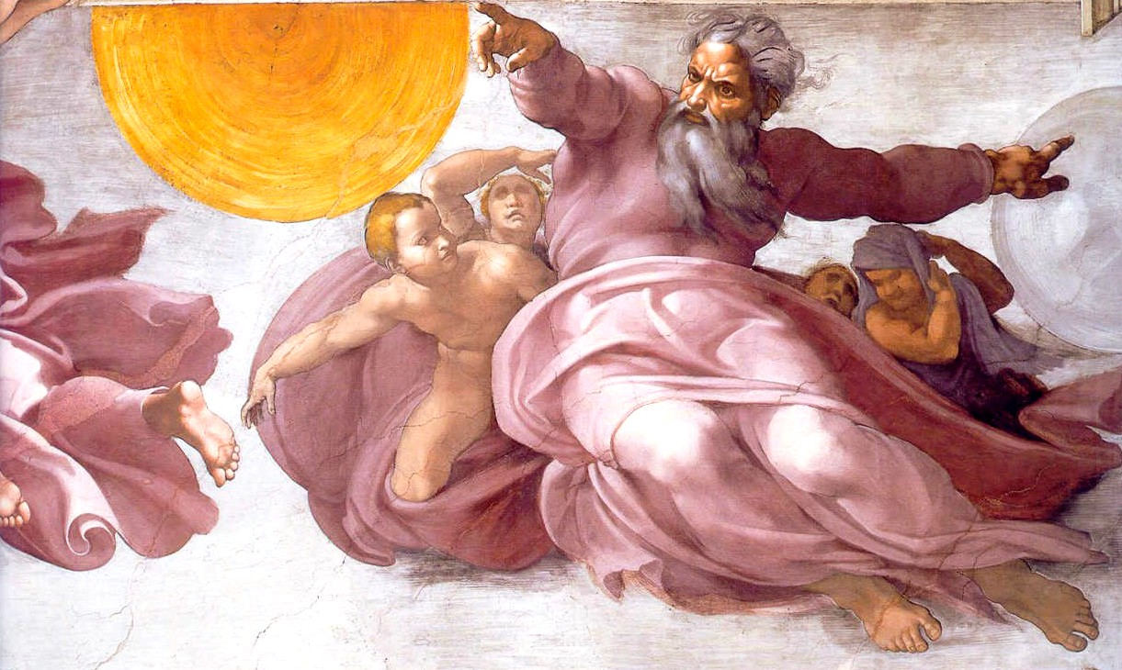
The Monomyth
Stage II: Initiation
Atonement with the Father
In most mythologies, the images of mercy and grace are rendered as vividly as those of justice and wrath, so that a balance is maintained, and the heart is buoyed rather than scourged along its way (p.107)
In every system of theology (…) the possibility of perfect knowledge is impaired. The problem of the hero is to peirce himself (and therewith his world) precisely through that point (p125)
Michelangelo, Creation, 1508-1512

Slide 36
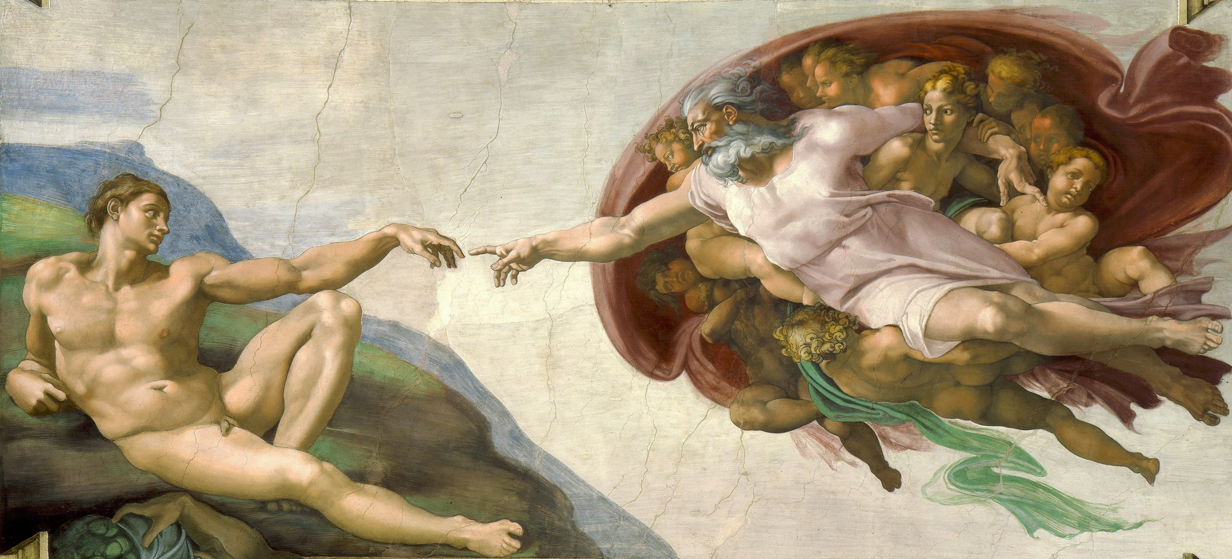
The Monomyth
Stage II: Initiation
Atonement with the Father
Michelangelo, Creation, 1508-1512

Slide 37
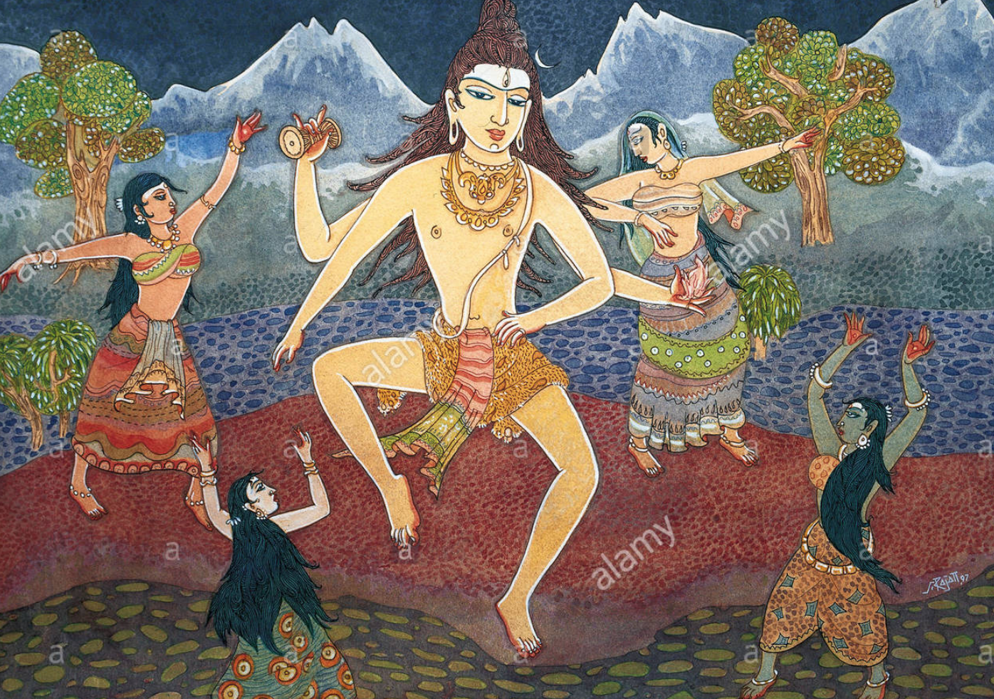
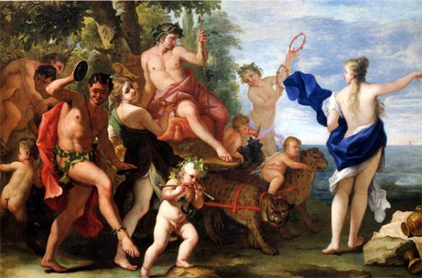
The Monomyth
Stage II: Initiation
Atonement with the Father
“Fear not, for all rests well in God. The forms that come and go - and of which the body is but one - are the flashes of my dancing limbs. Know Me in all, and of what shall you be afraid?”
S. Rajam, Dancing with Siva

Slide 38
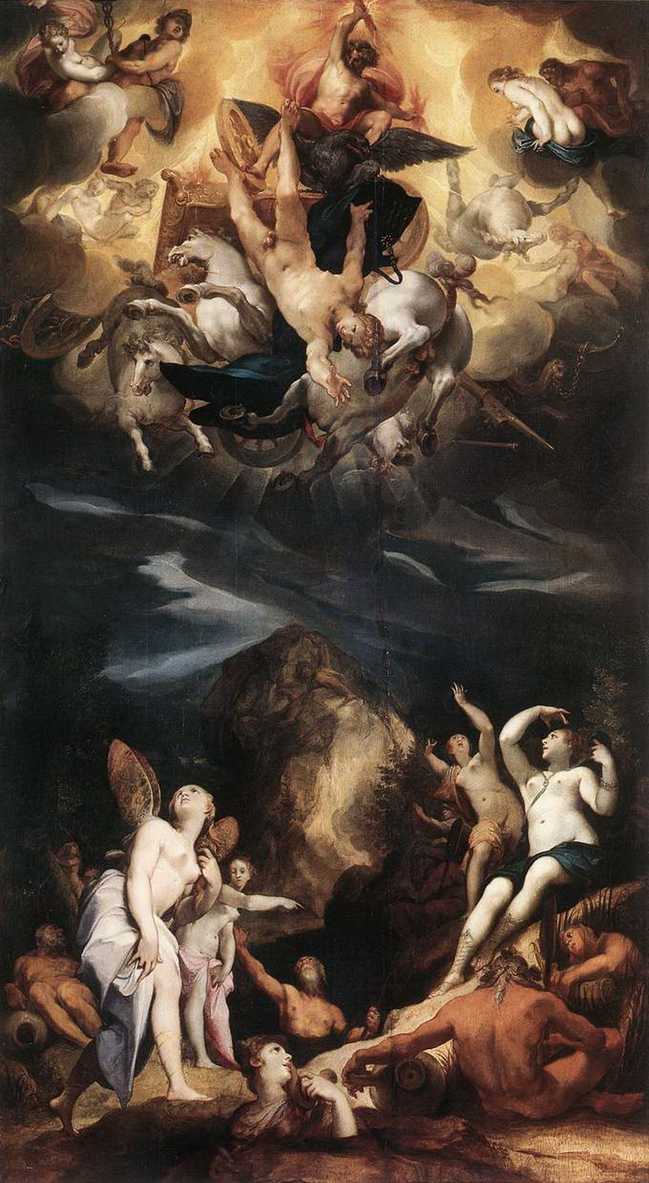
The Monomyth
Stage II: Initiation
Atonement with the Father
The Fall of Phaeton is a tale of indulgent parenthood that illustrates the antique idea that when the roles of life are assumed by the improperly initiated, chaos supervenes.
The traditional idea of initiation combines an introduction of the candidate into the techniques, duties, and prerogatives of his vocation with a radical readjustment of his emotional relationship to the parental images (p.115)
The Father is competent now to enact himself the role of the initiator, the guide, the sun door, through whom one may pass from the infantile illusions of “good” and “evil” to an experience of majesty of cosmic law, purged of hope and fear, and at peace in the understanding of the revelation of being (p.116)
Joseph Heinz, The Fall of Phaeton, 1596

Slide 39
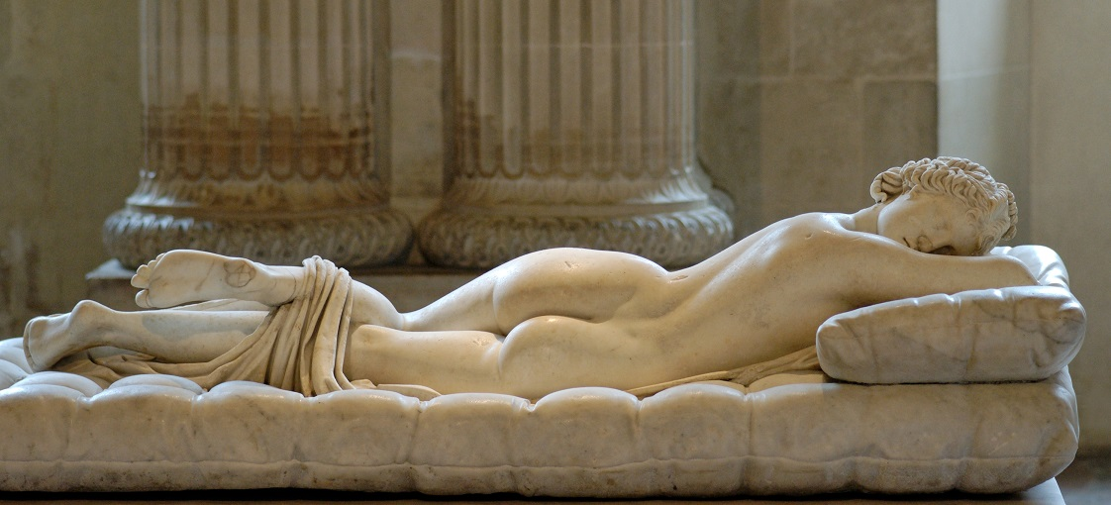
The Monomyth
Stage II: Initiation
Apotheosis
Gian Lorenzo Bernini, Sleeping Hermaphroditus, 1620
The hero is now made divine: The Mother/Father figure is incarnated in the hero himself. The hero is in his most powerful stage.

Slide 40
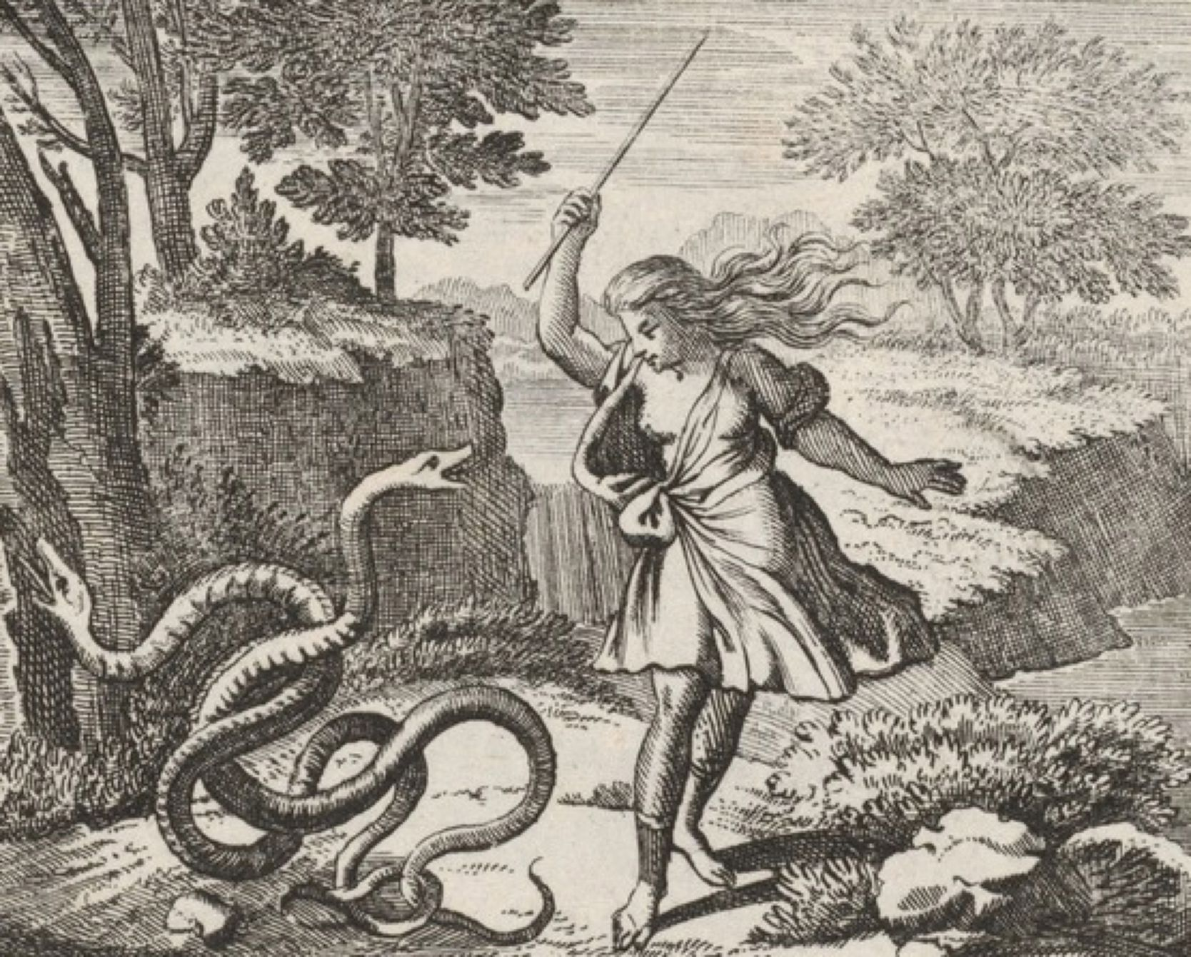
The Monomyth
Stage II: Initiation
Apotheosis
Time and eternity are two aspects of the same experience-whole (p.130) Male-female gods are not uncommon in the world of myth. They emerge always with a certain mystery; for they conduct the mind beyond objective experience into a symbolic realm where duality is left behind
It represents one of the basic ways of symbolizing the mystery of creation: (…) the generation of new life through the recon junction of the two (p.131)
Tiresias, the blinder seer, was both male and female: his eyes were closed to the broken forms of the light-world of the pairs of opposites, yet he saw in his own interior darkness the destiny of Oedipus (p.132)
Tiresias striking the snakes

Slide 41
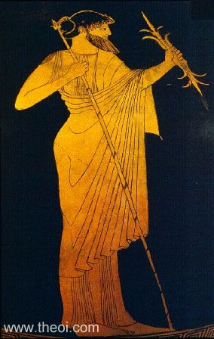
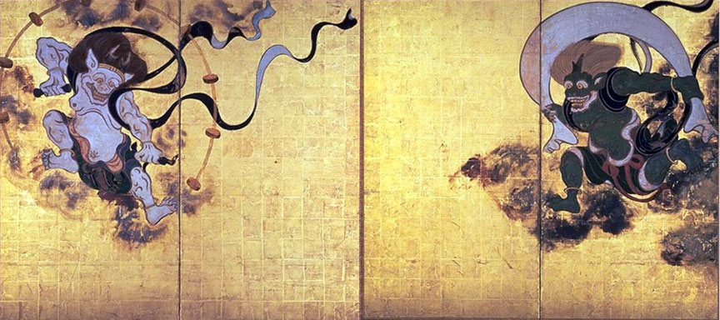
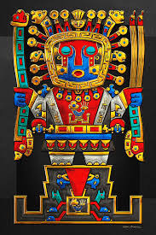
The Monomyth
Stage II: Initiation
The Ultimate Boon
The Boon has a symbolic tie with the theme of the whole story. The Boon is the knowledge that the hero goes on a quest to obtain.
The gods and goddess then are to be understood as embodiments of the elixir of Imperishable Beings but not themselves the Ultimate in its primary state.
What the hero seeks through his intercourse with them is therefore not finally themselves, but their grace, the power of their sustaining substance. This miraculous energy and this alone is the Imperishable (p.155)
Thunderbolt of Zeus
Thunderbolt of Yahweh
Thunderbolt of Viracocha

Slide 42
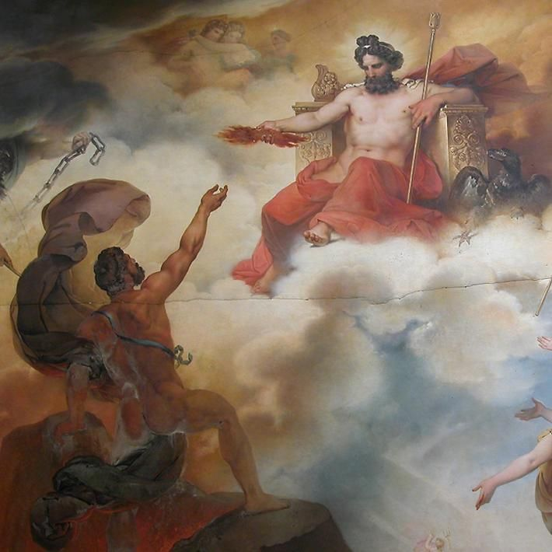
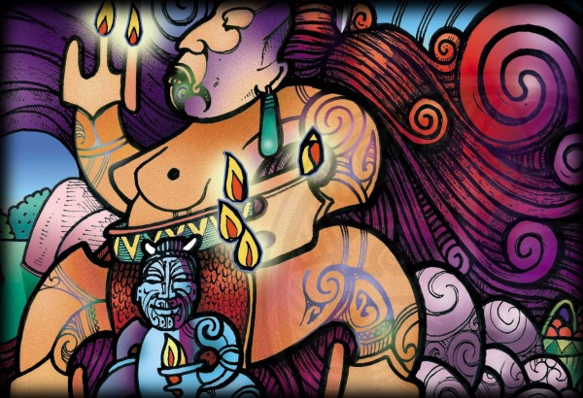
The Monomyth
Stage II: Initiation
The Ultimate Boon
The hero goes against the gods and must trick them to obtain their treasure.
Prometheus receiving the fire
Maui stealing the fire from Mhau-ika

Slide 43
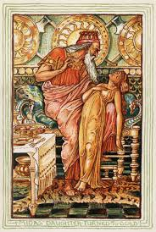
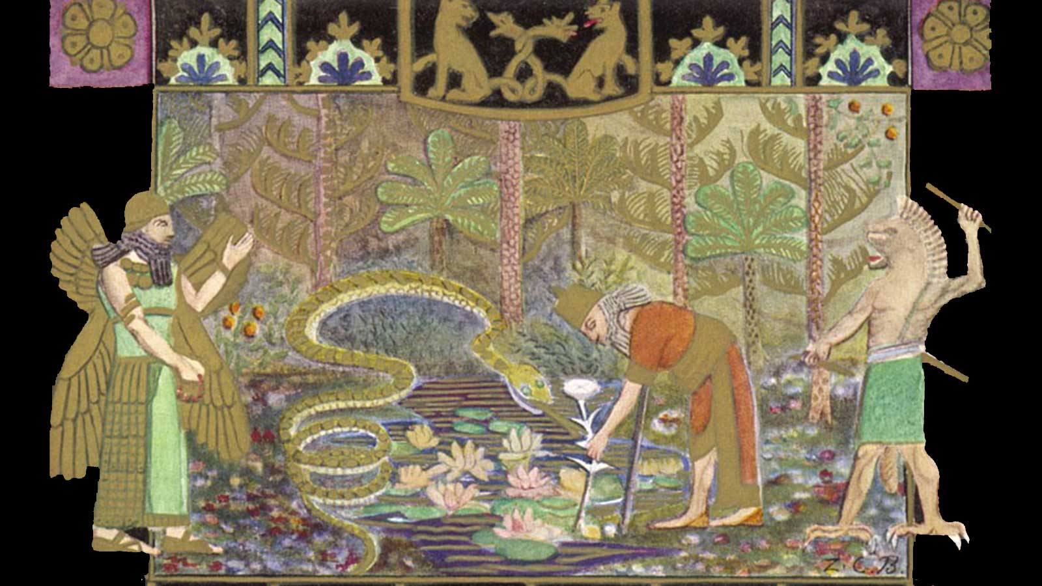
The Monomyth
Stage II: Initiation
The Ultimate Boon
Gilgamesh seeks the plant of Immortality Never Grow Old
King Midas

Slide 44
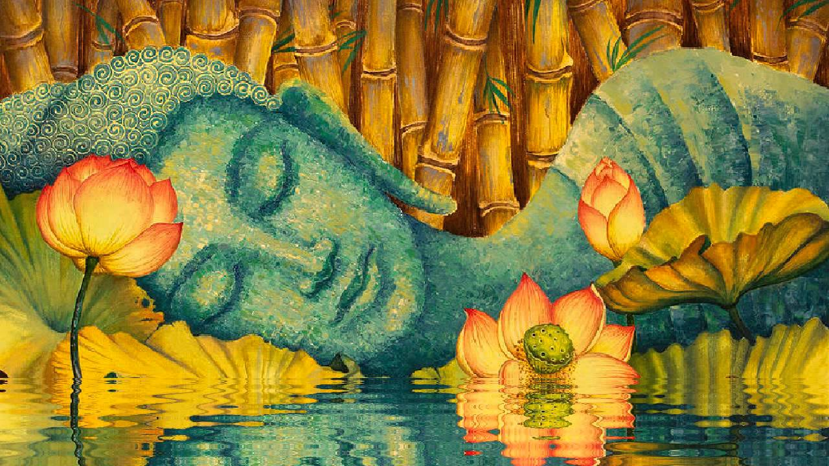
The Monomyth
Stage III: Return
Refusal of Return
When the hero questo has been accomplished, (…) the adventurer must still return with his life-transmuting trophy (…) where the boon may redound to the renewing of the community. But the responsibility has been frequently refused. (p.167)
Buddha doubted whether the message of realization could be communicated

Slide 45
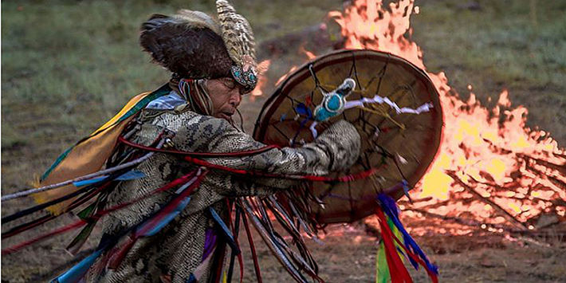
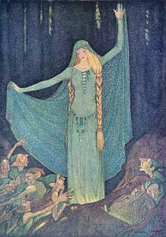
The Monomyth
Stage III: Return
The Magic Flight
The hero returns to the world with some elixir for the restoration of society, (…) but the flight may be complicated by marvels of magical obstruction and evasion (p.170).
Often a number of delaying obstacles are tossed behind by the wildly fleeting hero (p.174)
Shaman playing his drum (Siberia)
The Water Nixie, Grimm’s Fairy Tales No. 79

Slide 46
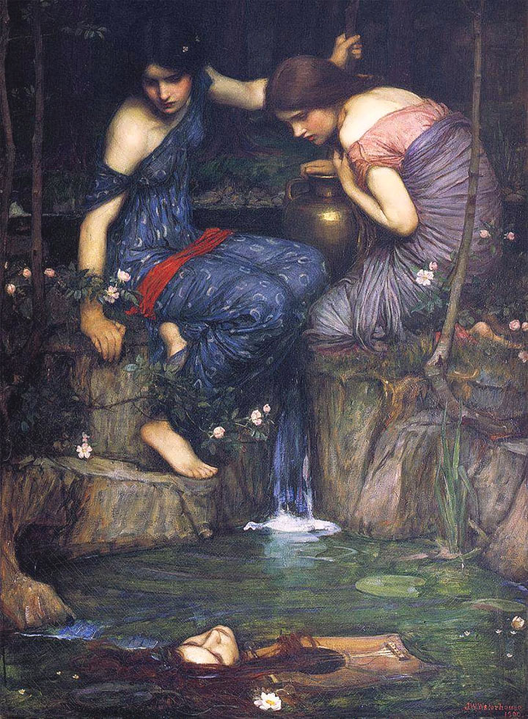
The Monomyth
Stage III: Return
The Magic Flight
A possibility exists of a return of the lover with his lost love from beyond the terrible threshold. It is always some little fault, some slight yet critical symptom of human frailty, that makes impossible the open interrelationship between the worlds (p.178)
John William Waterhouse, Orpheus, 1900

Slide 47
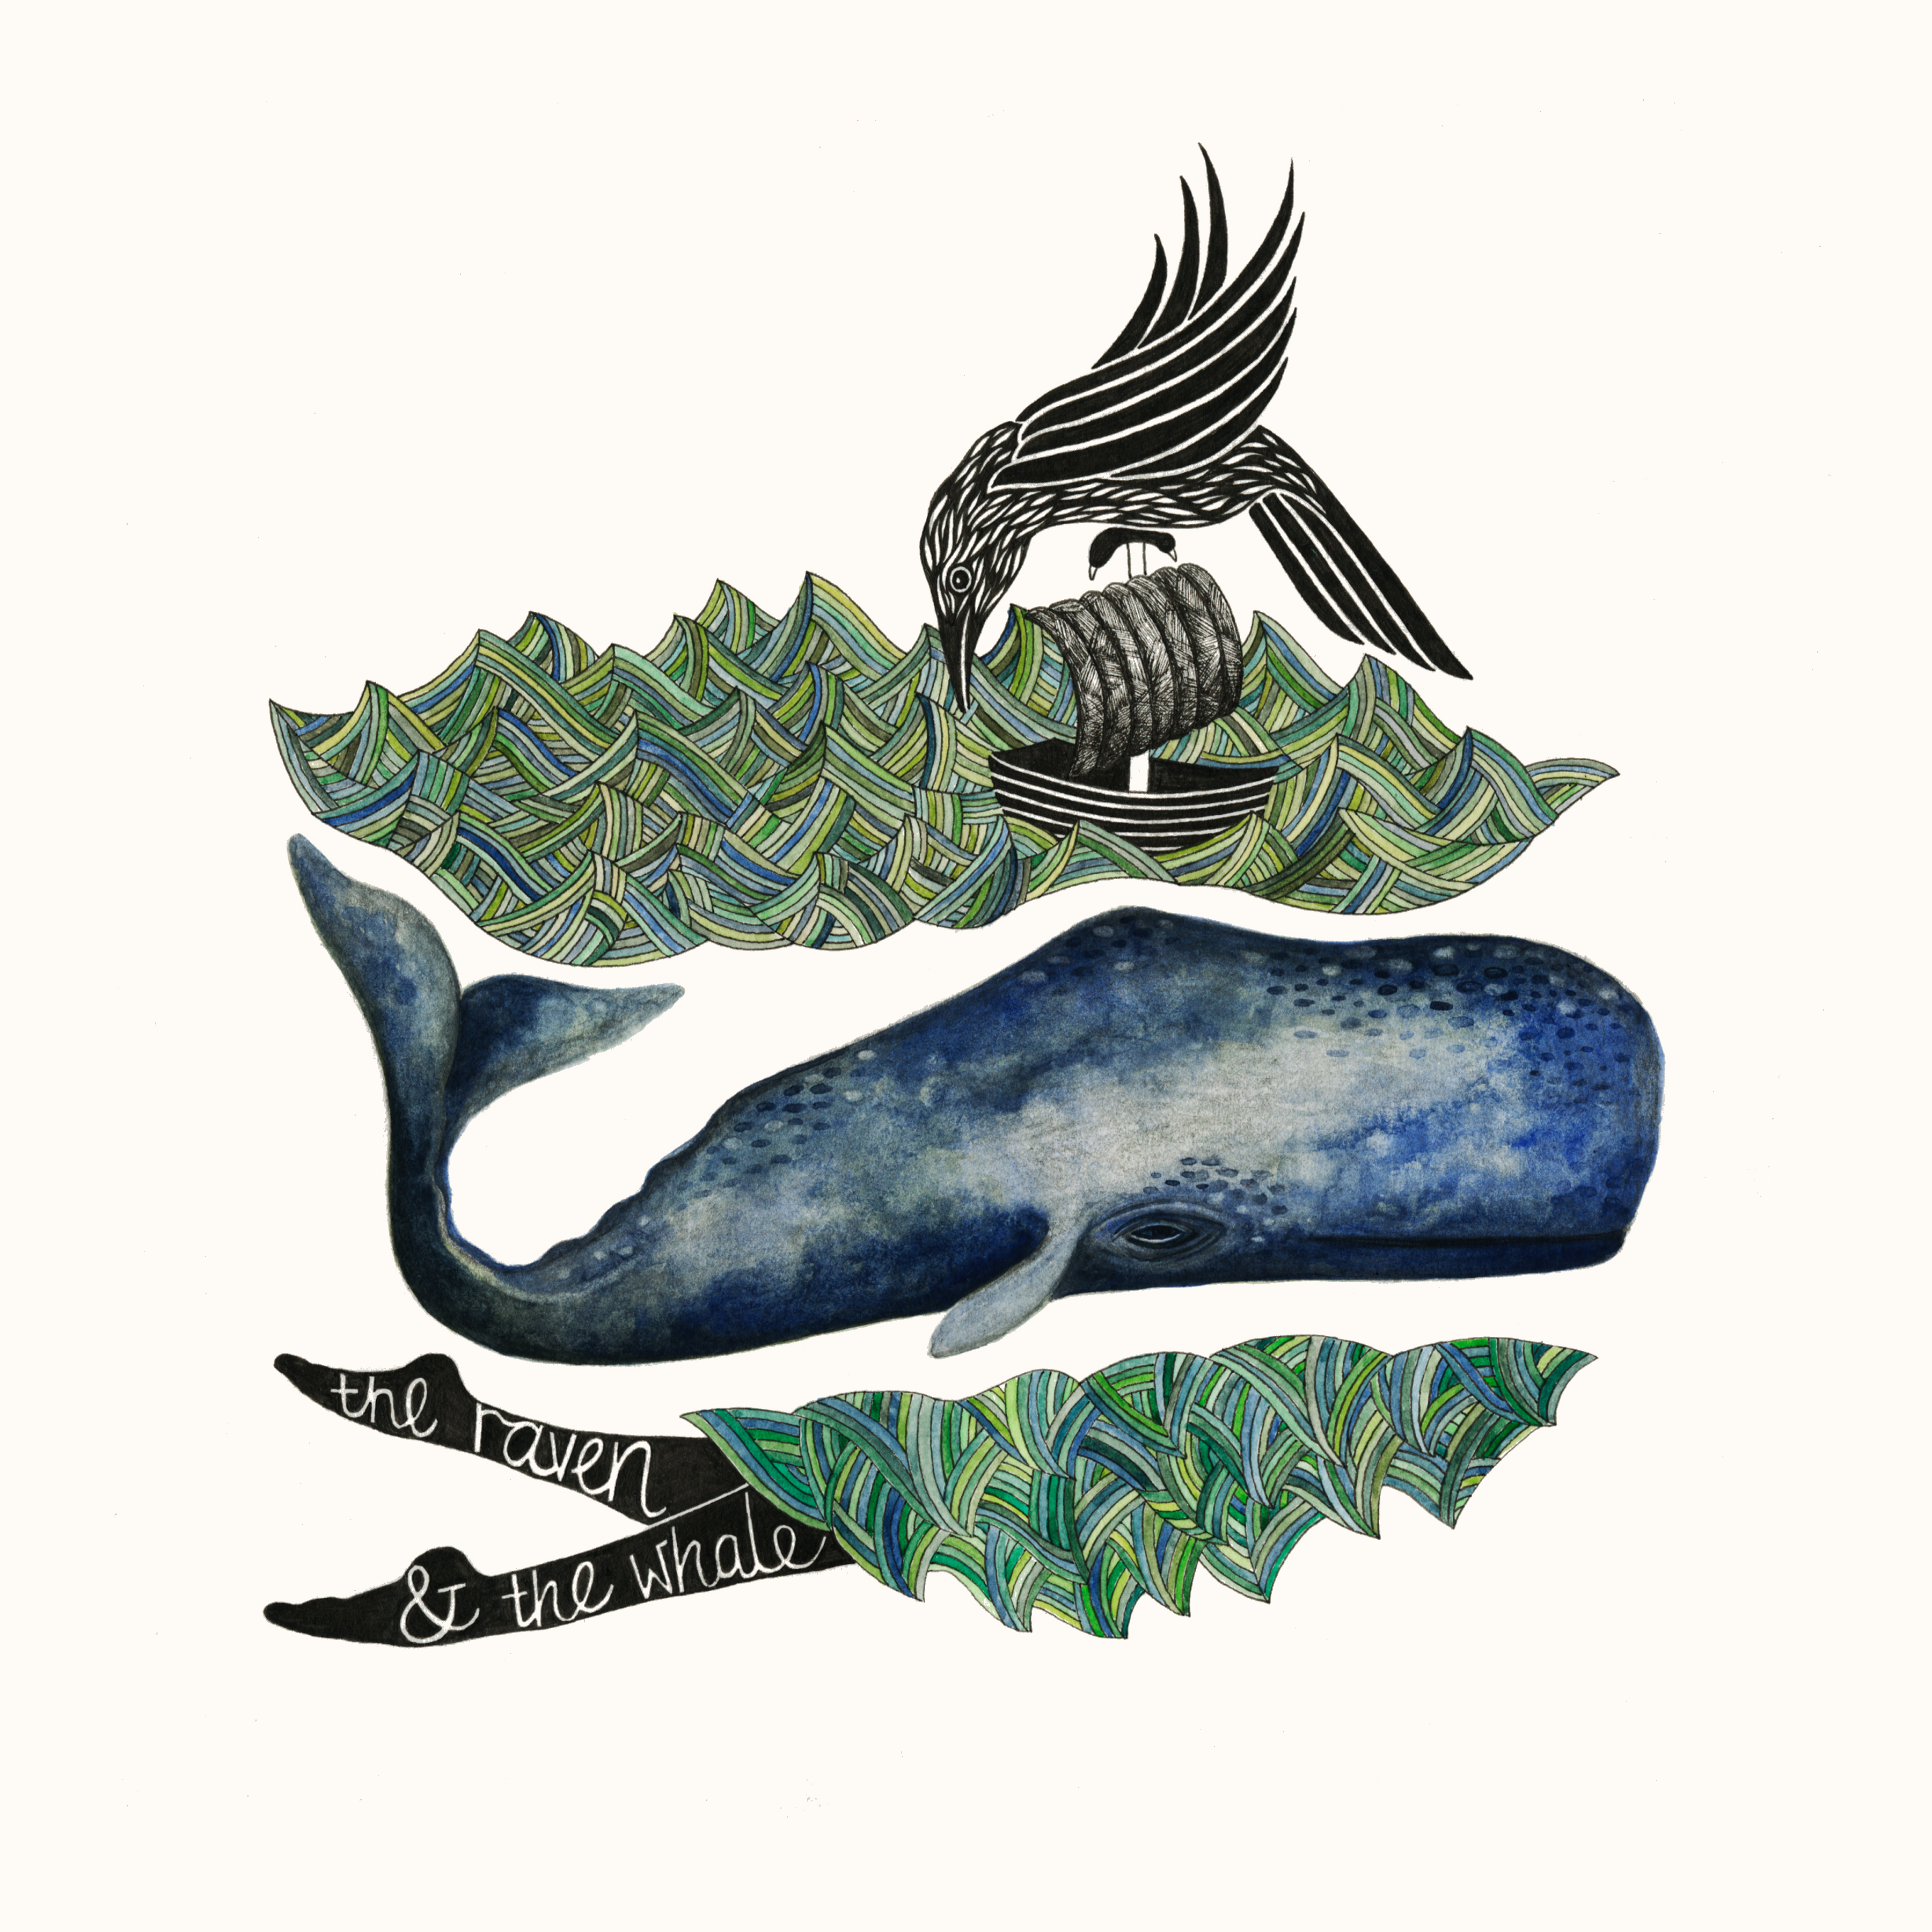
The Monomyth
Stage III: Return
Rescue from Without
The world may have to come and get the hero.
The Rescue from Without stage show the continued operation of the supernatural assisting force that has been attending the elect through the whole course of his ordeal.
His consciousness having succumbed, the conscious nevertheless supplies its own balances, and he is born back into the world from which he came.
Instead of holding to and saving his ego, as in the pattern of the magic flight, he loses it, and yet, through grace is returned (p.186)
the hero has yet to re-enter with his boon the long-forgotten atmosphere where men who are fractions imagine themselves to be completed. He has yet to confront society with his ego-shattering, life-redeeming elixir, and take and return blow of reasonable queries, hard resentment, and good people at a loss to comprehend.
The Raven and the Whale, Inuit folk tale

Slide 48
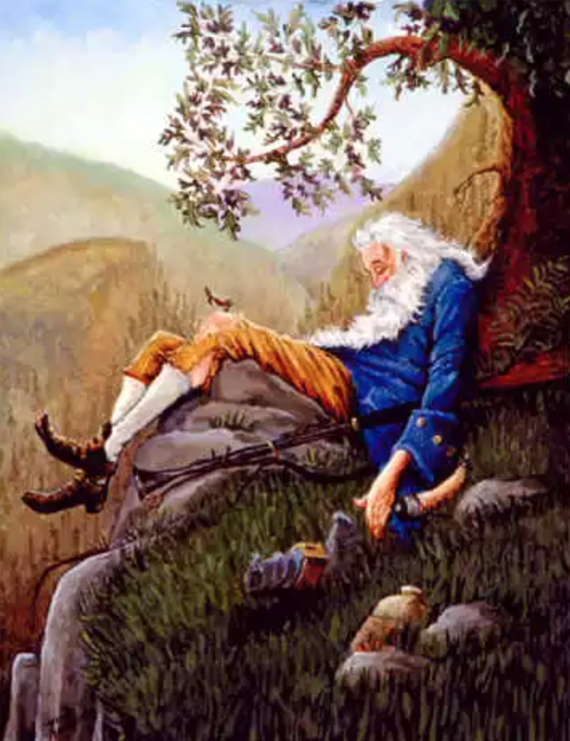
The Monomyth
Stage III: Return
The Crossing of the Return Threshold
The realm of the gods is a forgotten dimension of the world we know. And the exploration of that dimension (…) is the whole sense of the deed of the hero.
The values and distinctions that in normal life seem important disappear with the terrifying assimilation of the self into what formerly was only otherness (p188)
How to teach again (…) is the hero’s ultimate difficult task. How render back into light-world language the speech-defying pronouncement of the dark? (p.189)
The first problem of the returning hero is to accept as real, after an experience of the soul-satisfying vision of fulfillment, the passing joys and sorrows, banalities and noisy obscenities of life (p.189)
Rip van Winkle

Slide 49
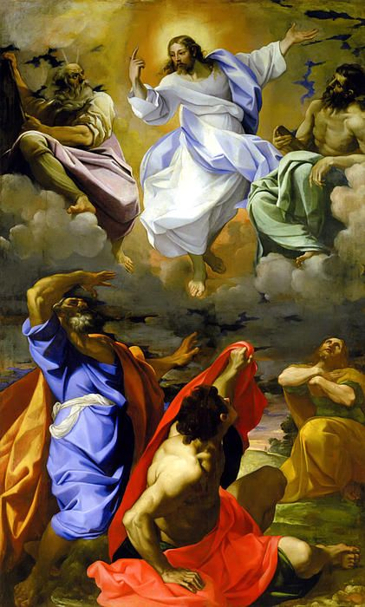
The Monomyth
Stage III: Return
Master of the Two Worlds
The transfiguration of [the hero] Jesus is witnessed was witnessed by devotees who had extinguished their personal wills, men who had long since liquidated “life”, “personal fate”, “destiny”, by complete self-abnegation in the Master (p. 202)
The mastery is the ultimate state of anonymous presence (p.205)
The individual (…) gives up completely all attachment to his personal limitations, idiosyncrasies, hopes and fears (…) his personal ambitions being totally dissolved, he no longer tries to live but willingly relaxes to whatever may come to pass in him; he becomes, that is to say, an anonymity (p. 205)
Lodovico Carracci, Transfiguration, 1594

Slide 50
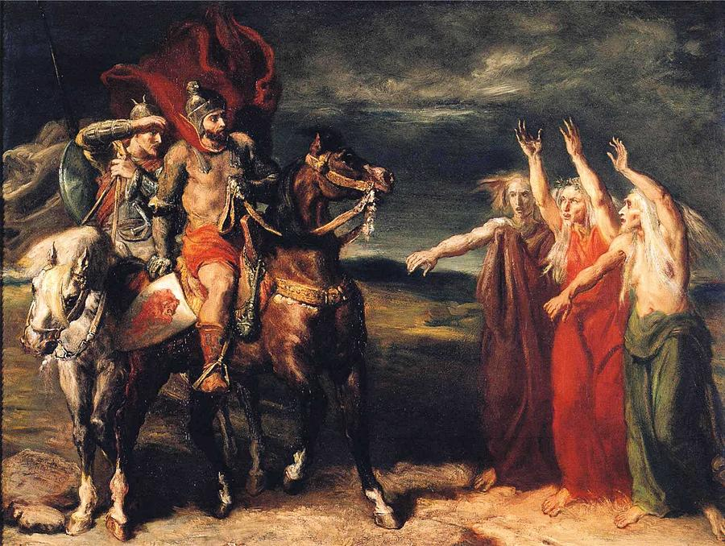
The Monomyth
Stage III: Return
Freedom to Live
The hero changed and faces problems differently. The normal world has regained its balance. If the hero is tragic, he didn’t learn from his mistakes and he finally understands and admits it.
Tomorrow, and tomorrow, and tomorrow,
creeps in this petty pace from day to day,
to the last syllable of recorder time;
and all our yesterdays have lighted fools
the way to dusty death.
Out, out, brief candle!
Life’s but a walking shadow, a poor player,
that struts and frets his hour upon the stage, and then is heard no more.
It is a tale told by an idiot,
full of sound and fury,
signifying nothing.
Theodore Chasseriau, Macbeth and the Three Witches, 1855

Slide 51
The Monomyth
Call to adventure
The hero, setting forth from his common-day castle is lured to the threshold of adventure.
Threshold Crossing
There he encounter a shadow presence that guards the passage.
The hero may defeat or conciliate this power and go alive into the kingdom of the dark, or be slain by opponent and descend in death (dimemberment, cruxifixtion)
Beyond the threshold, the hero journeys through a world of unfamiliar yet strangely intimate forces, some of which severely threaten him (tests), some of which give magical aid (helpers).
Road of Trials
Rewards
When he arrives at the nadir, he undergoes a supreme ordeal and gains his reward.
Sacred Marriage
The triumph may be presented as the hero’s sexual union with the goddess-mother of the world (sacred marriage), his recognition by the father-creator (father atonement), his own divination (apotheosis), or again - if the powers have remained unfriendly to him- his theft of the boon he came to gain. instrinsically it is an expansion of consciousness and therewith of being (illumination, transfiguration, freedom).
Father Atonement
Apotheosis
Elixir Theft
Return
The final work is that of the return. If powers have blessed the hero, he now sets forth under their protection; if not, he flees and is pursued (magic flight).
Magic Flight
At the return threshold the transcendental powers must remain behind; the hero reemerges from the kingdom of dread (return, resurrection).
Threshold Struggle
Elixir to the world
The boon that he brings restores the world.

Slide 52
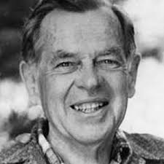
The Monomyth
I don’t believe people are looking for the meaning of life as much as they are looking for the experience of being alive
We humans reflect on our world through symbolic stories of our own lives
A hero is someone who has given his or her life to something bigger than oneself
The big question is whether you are going to be able to say a hearty yes to your adventure
Joseph Campbell (1904-1987)
We must be willing to get rid of the life we’ve planned, so as to have the life that is waiting for us
The cave you fear to enter holds the treasure that you seek.

