Slide 1
Storytelling in Advertising
Lesson #4

Slide 2
Objectives of the lesson:
Storytelling as the central driving force for advertising
Advertising as Serials
Advertising as a channel to convey values
Reference: Fog, Butz, Yakaboylu, Storytelling, Branding in Practice, 2005
(pp. 151-173)

Slide 3

The Tree of Corporate Storytelling
Story-telling and Story-listening
Content Management
Structure of Stories
Branding in Practice
Sense-making

Slide 4
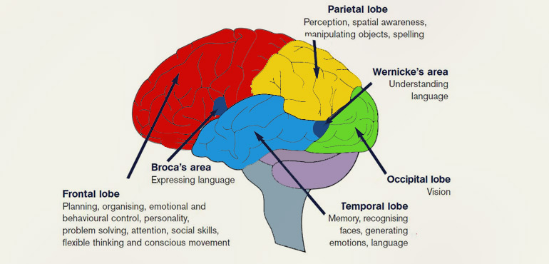
The Responsibility of Communication

Slide 5
sounds
words
sentences
full engaging and coherent story

Slide 6
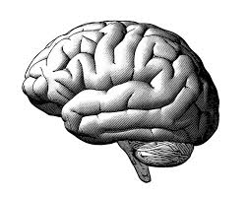
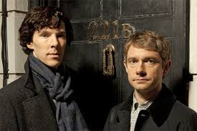
Test 1: SHERLOCK
RESULTS
1, 2, 3
always the same brain patterns
1
A
transmission of knowledge and memories across people
2
A
3
our ability to communicate relies on our ability to have common ground
A
B

Slide 7
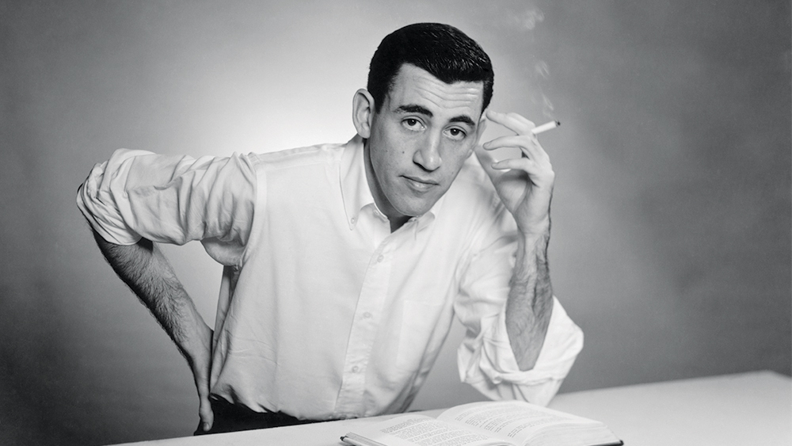
Test 1: J.D. SALINGER
RESULTS
G1 is now made of individuals with similar patterns.
G1
the wife is having an affair with his best friend
G2 is now made of individuals with similar patterns.
G2
Did you see my wife?
he is jealous, she is loyal
G1 & G2 show different patterns

Slide 8
1 sentence is enough to make your brain similar to people who think like you
and very different than people that think differently than you
Think about the consequences and the responsibility of communication

Slide 9
Brands use storytelling to convey their values.
To do so, they use advertising.
But how and why?

Slide 10
Advertising as Serials
Started in the late 80s
The trademark of the serial is that the product and price focus is set aside, in favor of a story that aims to entertain and involve the audience emotionally

Slide 11
Advertising as Serials
it gets transmitted more easily
Message
it drives the story forward: makes us more deeply involved
they can evolve over time.
we can identify
(mimesis)
Conflict
Characters
Plot

Slide 12
The advantage of the commercial serial is that it creates a long-term platform for the company to communicate its messages, and establishes a long-term relationship with the viewer
Advertising as Serials

Slide 13

Market: USA
Year: 2001
Values: luxury, innovation, technology
Case: BMW

Slide 14
Case: BMW

Slide 15
Case: BMW
PROBLEM
SOLUTION
BMW decreased sales in the US
marketing strategy
brand repositioning
SALES = MARKETING
co-values of the brand: manliness, sport cars, power
increase brand identity in the US market
convey values of luxury, innovation, technology

Slide 16
Case: BMW
problem
sales decreased (2000)
strategy
brand repositioning
use of storytelling (serial = 8 movies)
operational
flip the % production/media ($24M total)
Hollywood-style short-films
Internet distribution (2001)
advertainment (branded content)
resolution
sales up 17,4% (2002) + awards +
outsold Mercedes +
100M views (pre-Youtube)

Slide 17

https://youtu.be/PKYUtUw-8ig

Slide 18
Stories: real of fictional?
(a story doesn’t need to be authentic to work: Rashomon effect)
Advertising as Serials
Telling the Real Story

Slide 19

Year: 2004-2019
Values: Real Beauty
Case: DOVE

Slide 20
Case: DOVE
PROBLEM
SOLUTION
The Real Truth About Beauty: a Global Report
=
only 2% of women describe theirselves as beautiful
has beauty became unachievable?
widening the definition of beauty
CUSTOMER
RELATIONS
=
PR
convey the real value of beauty through a redefinition of the value

Slide 21
Case: DOVE
PROBLEM
The Real Truth About Beauty: a Global Report
=
only 2% of women describe theirselves as beautiful
“the limited portrayal of beauty is preventing women from recognizing and enjoying beauty in themselves and in others
target: girls 14 to older women 65 yo

Slide 22
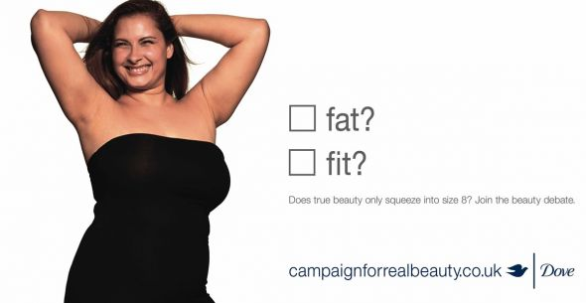

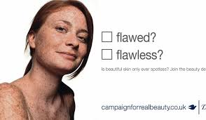
DOVE tick box (2004)

Slide 23
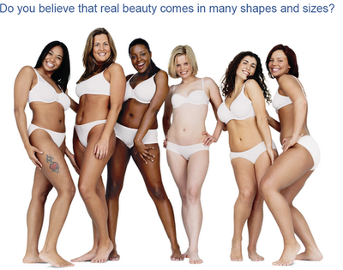
DOVE Real Beauty Come in all Shapes and Sizes (2005)

Slide 24

“No Wonder Our Perception of Beauty is Distorted” (2006)
https://youtu.be/iYhCn0jf46U

Slide 25
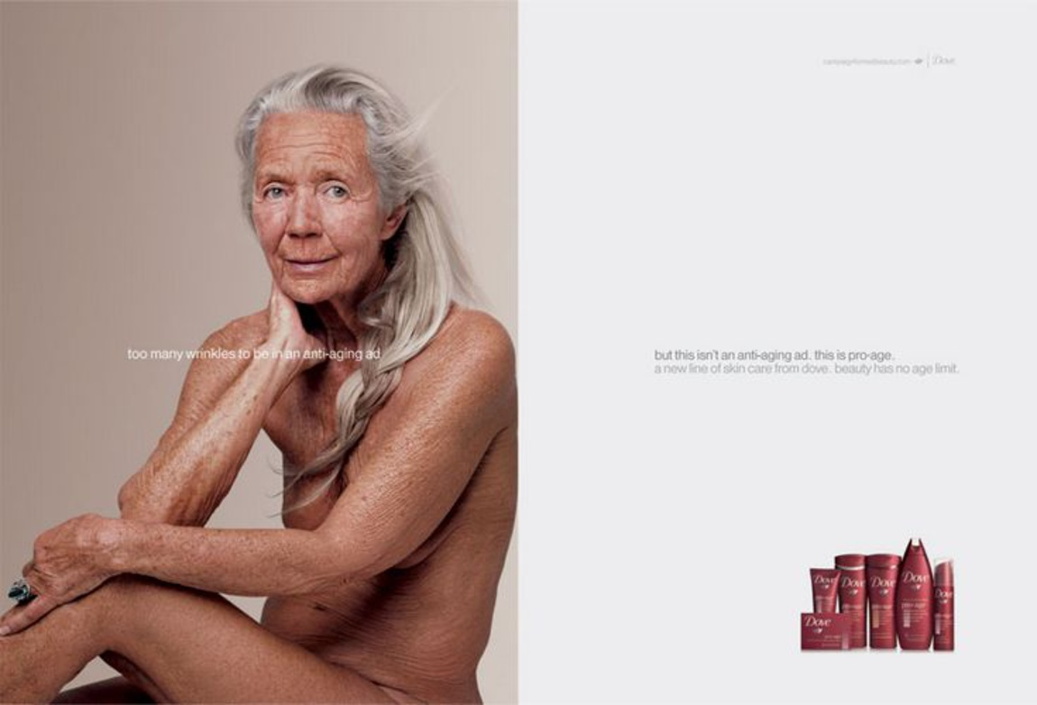
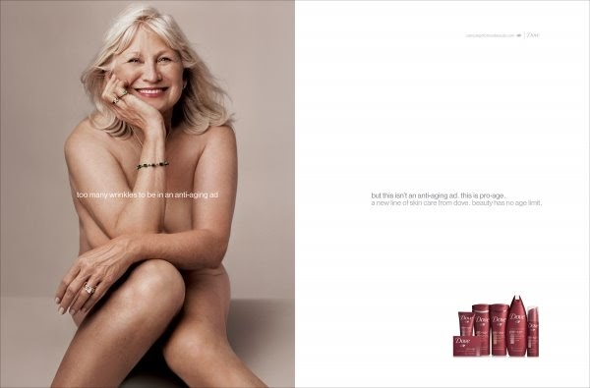
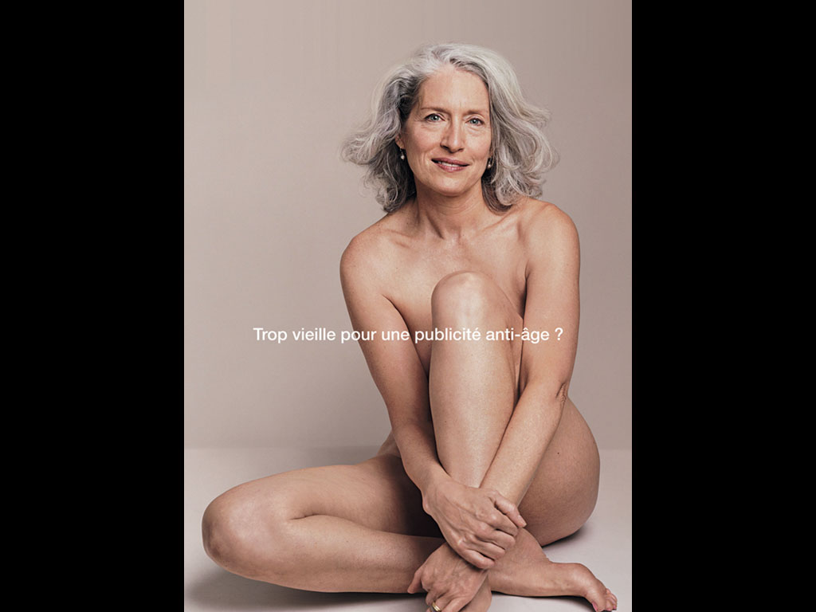
DOVE: Focusing on women ages 50-64 (2007-08) (ph: Annie Leibovitz)

Slide 26
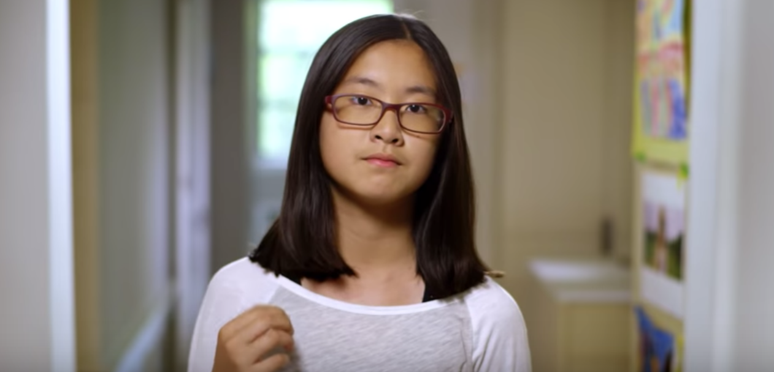

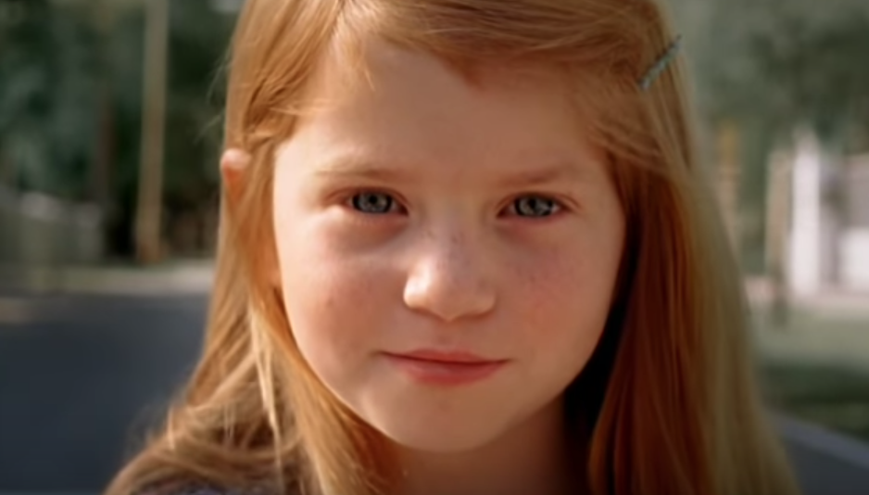
DOVE: Self-esteem project (2010)
https://youtu.be/c96SNJihPjQ
https://youtu.be/ABhTaFWIrO4
https://youtu.be/Ei6JvK0W60I

Slide 27
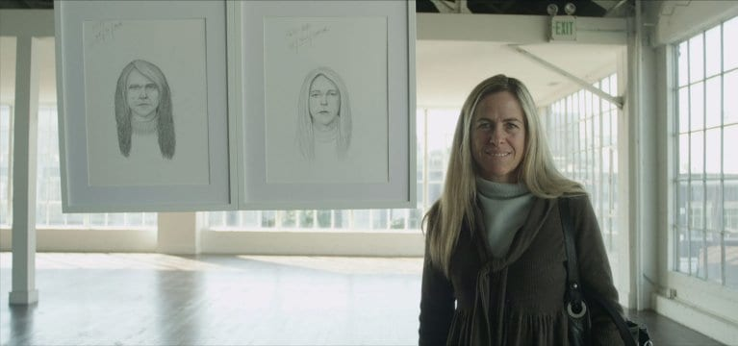
DOVE: Sketches (2013)
https://youtu.be/XpaOjMXyJGk

Slide 28
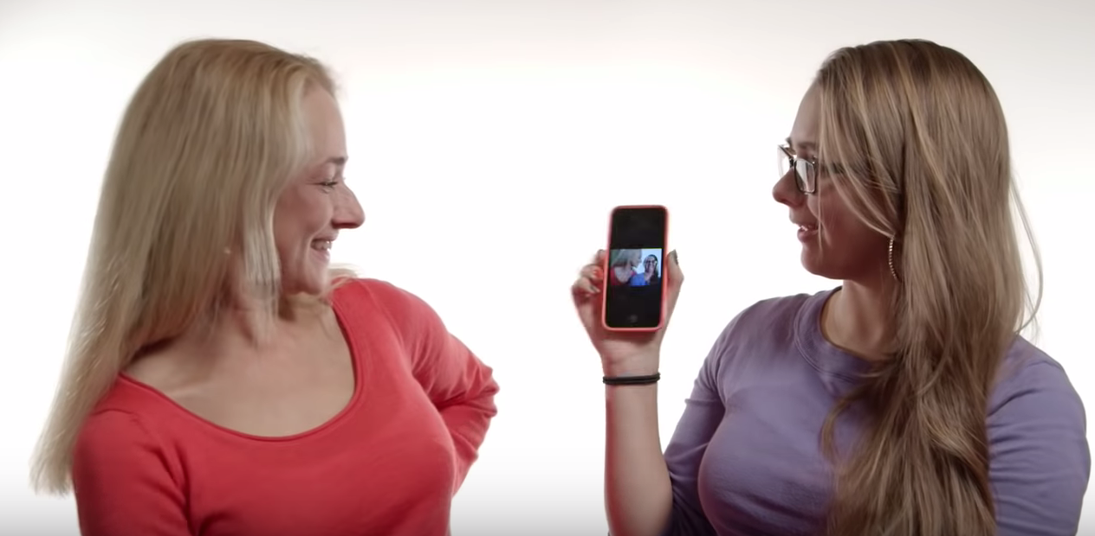

DOVE: Selfie (2014), Legacy (2014)
https://youtu.be/_3agBWqGfRo
https://youtu.be/Pqknd1ohhT4

Slide 29
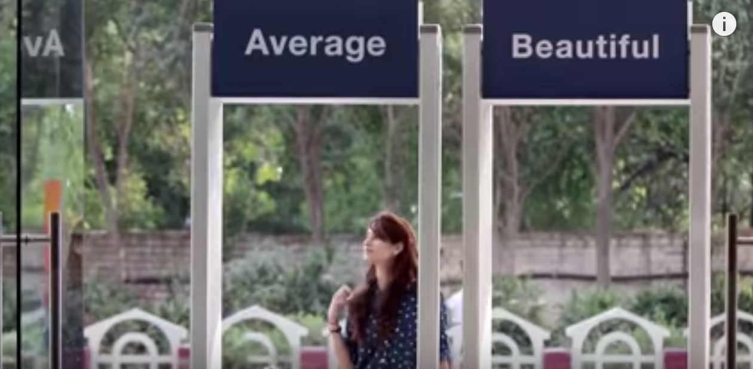
DOVE: Choose Beautiful (2015)
https://youtu.be/7DdM-4siaQw

Slide 30
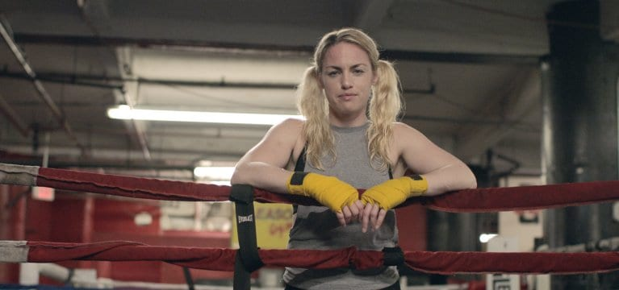
DOVE: My Beauty, My Say (2016)
https://youtu.be/_XOa7zVqxA4

Slide 31
Case: DOVE
problem
distorted value of Beauty
strategy
social communication (CSR)
use of storytelling to create series based on values
operational
a new concept of beauty
self-esteem value
mother - daughter relationship
resolution
change the concept of beauty
for girls and women +
brand associated
with social responsibility

Slide 32

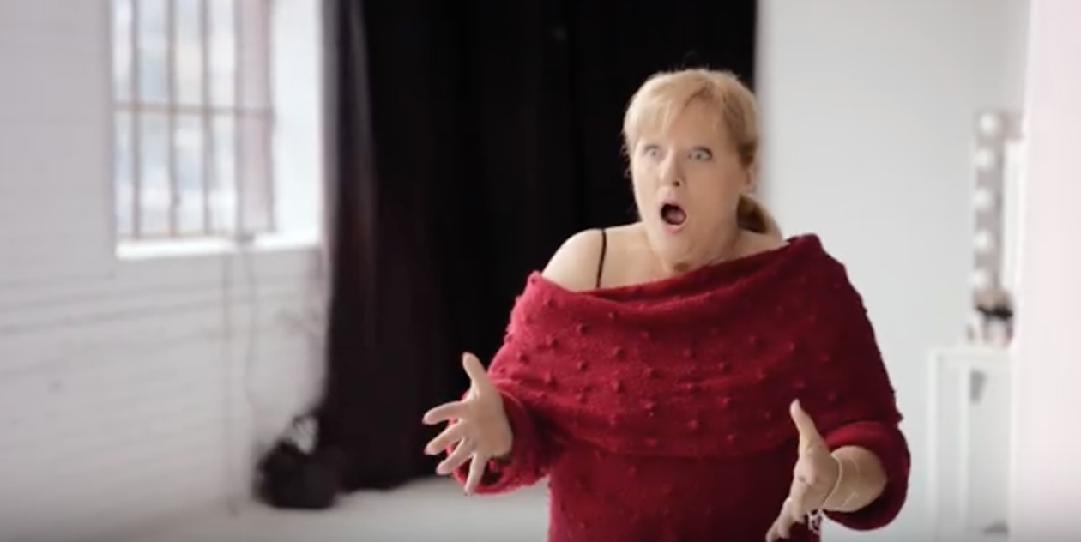
AXA: Reflections (2019)
https://youtu.be/ZfJR3Rp0Zn8

Slide 33
Companies use stories to convey meanings and values.
Storytelling is the art of
imitation with the character
(mimesis)

Slide 34
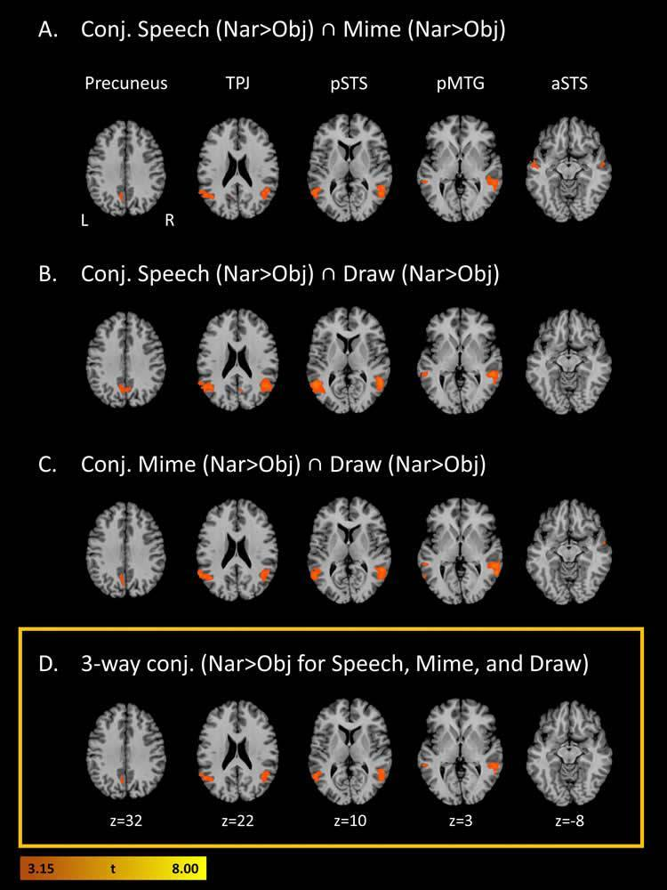
fMRI: participants presented with short narrative prompts akin to newspaper headlines (e.g. “Surgeon finds scissors inside of patient” or “Fisherman rescues boy from freezing lake”).
Then they were asked to convey the stories using speech, gestures or drawing.
Our brain relate best to characters, no matter how the narrative is expressed
(Neurosciencenews, 2018)

