Slide 1
Storytelling as a Management Tool
Lesson #3

Slide 2
Objectives of the lesson:
Explain the importance of Stories as management tools
Describe any core story
Describe the Storytelling-circulation model
Reference: Fog, Butz, Yakaboylu, Storytelling, Branding in Practice, 2005 (pp. 126-149)

Slide 3

The Tree of Corporate Storytelling
Story-telling and Story-listening
Content Management
Structure of Stories
Branding in Practice
Sense-making

Slide 4
Stories as a management tool
Consider stories as a supplement to traditional management tools:
identify stories which best communicate the company’s core story
STRENGHTEN THE CULTURE
VISION
the beginnings
present
future
explain company’s values through stories:
the abstract values become TANGIBLE
show employees / stakeholders how they should behave in certain situations to uphold company values

Slide 5
The company Core Story must be transformed into a collection of concrete stories relevant for the employees, customers, stakeholders

Slide 6

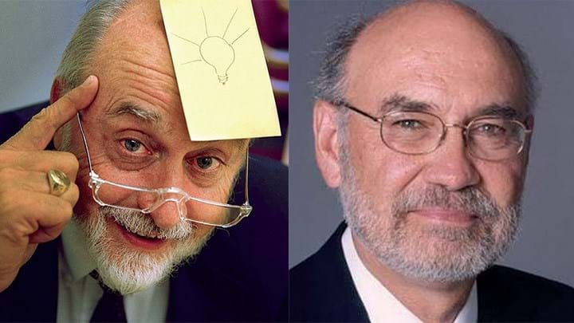
Arthur Fry
Silver Spencer

Slide 7

3M
Geoff Nicholson

Slide 8
3M core story
Payoff: “Innovation at all costs”
Description: 3M fights a daily battle
to make people’s lives easier through new inventions
Adversary = bureaucracy & narrow sightedness

Slide 9

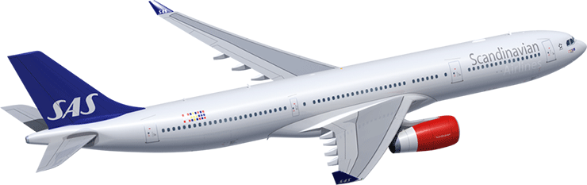

Slide 10
SAS core story
Payoff: “The Businessman Airline”
Description: an airline that would do anything in its power
to ensure that the busy, traveling businessman/woman
would get to his/her destination on time
Adversary = traditional hierarchical approach

Slide 11

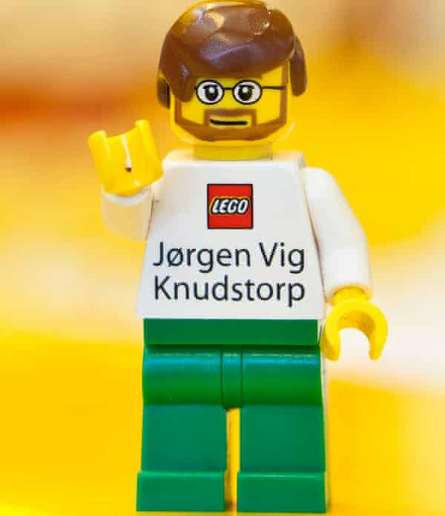

Slide 12
LEGO: fall and rise
2003
2015
$800m debt
larger variety
out of focus
same market
same audience
$600m profit
reduced variety
regain focus
new markets
know your audience

Slide 13

know your audience
“We call it ‘camping with consumers’. My team spends all our time travelling around the world, talking to kids and their families and participating in their daily lives. This includes watching how kids play on their own and with friends, how siblings interact and why some toys remain perennial favourites while others are relegated to the toy box”.
Anne Flemmert Jensen, senior director of its Global Insights group.

Slide 14
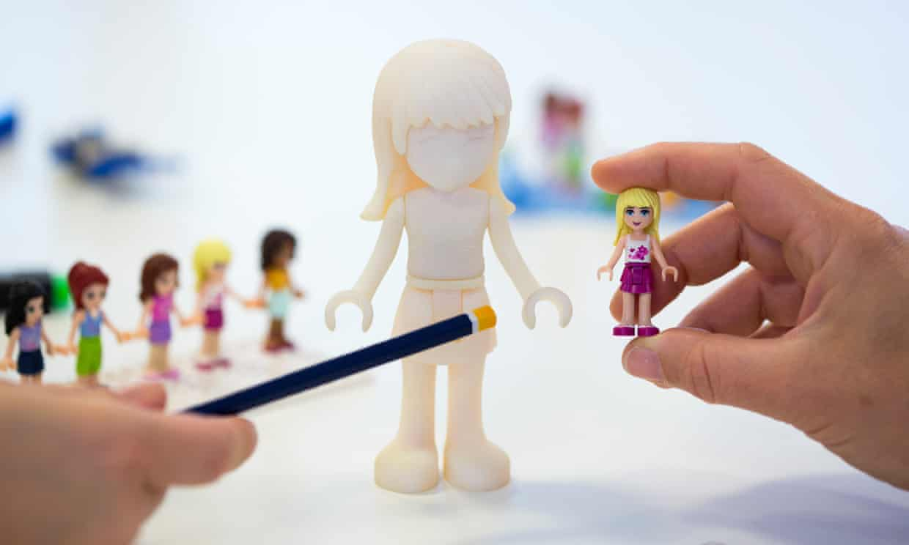
explore new markets
“One of the main things was they couldn’t really relate to the Minifigure. It’s too blocky. Boys tend to be a lot more about good versus evil, whereas girls really see themselves through the Mini-doll. They wanted a greater level of detail, proportions and realism.”
Mauricio Affonso, Friends’ model designer

Slide 15

brand stretching
““The reality is that the last few years the growth has been supernatural. When you look at the proportion of revenue that’s coming out of the mature markets it becomes more and more challenging with the level of penetration. But we look at every year starting at zero because you have to recruit every child again and make the brand exciting for them. That becomes a good challenge, of course.”
Julia Goldin, Lego’s chief marketing officer.

Slide 16
LEGO core story
Payoff: “…”
Description: …
Adversary = …

Slide 17
Who are the heroes of the company?
What qualities does the hero possess in these stories?
What challenges and adversaries does the hero face?
What characterizes these challenges?
How does the hero tackle these challenges?
What values lie in the message of the story?
Does the story support the company brand?

Slide 18

The Symbolic Significance of the CEO
“There’s always a first time for everything. That’s why I’m a virgin, I suppose” Richard Branson

Slide 19
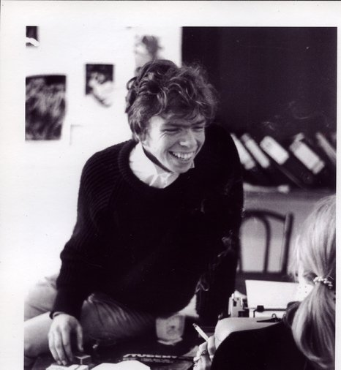

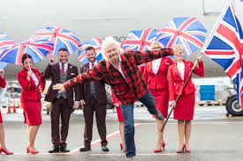

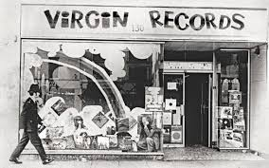
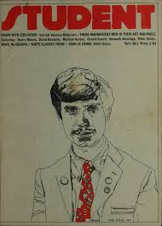
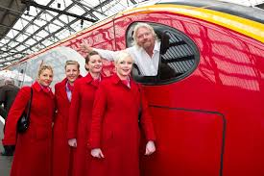
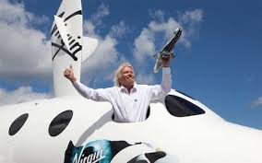
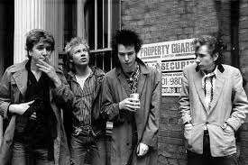
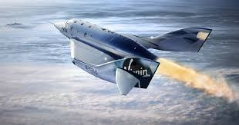

Slide 20
VIRGIN core story
Payoff: “…”
Description: …
Adversary = …

Slide 21
Storytelling-circulation
gather stories (workshops, interviews with key personnel)
SEARCH
management ensures stories are told continuously
list stories and those with depth and relevance are selected for further processing
SHARE
SORT
SHOW
SHAPE
tell the story through the right channel
4 elements of storytelling to make stories “tell-able”

