Slide 1
Storytelling as a Branding Practice
Lesson #2

Slide 2
Objectives of the lesson:
Understand the concept of Storytelling as a Branding practice
Define and Produce the Company Core-Story
Reference: Fog, Butz, Yakaboylu, Storytelling, Branding in Practice, 2005
(pp. 30-95)

Slide 3

The Tree of Corporate Storytelling
Story-telling and Story-listening
Content Management
Structure of Stories
Branding in Practice
Sense-making

Slide 4
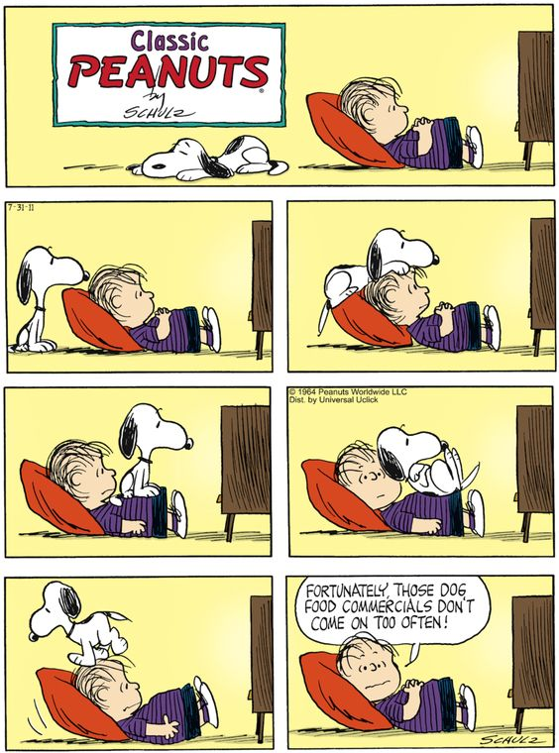
Sometimes stories are like this…

Slide 5
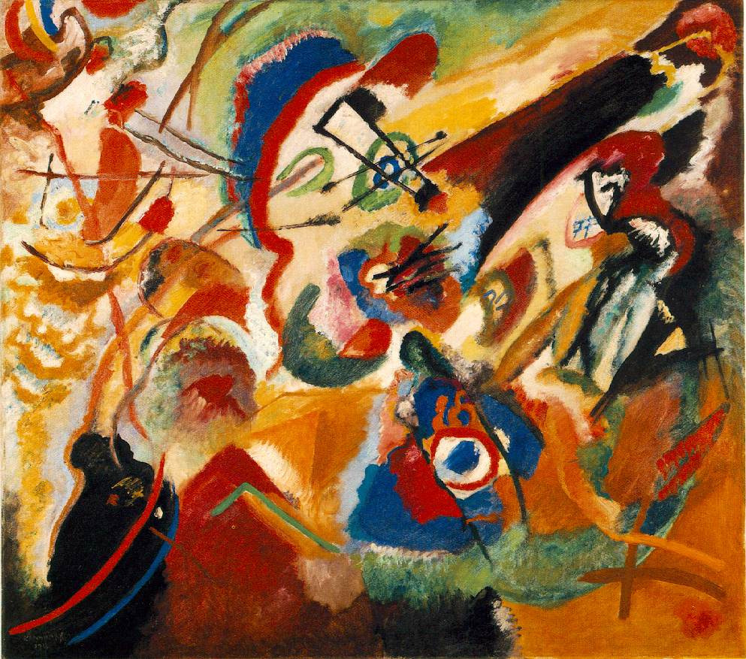
…but most of the times they are like this

Slide 6

Sense-making
“Telling stories is the only way we can create meaning in our lives
and make sense of the world”
(Paul Auster)

Slide 7
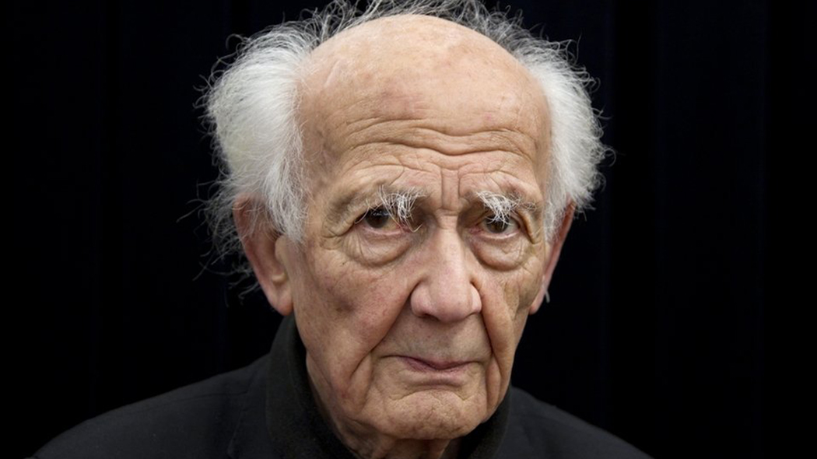
Liquid Modernity
Zygmunt Bauman (1925-2017)
In a liquid modernity the meaning is fragmented.
The value systems that have traditionally served as guides for us are coming undone.
We are desperately searching for meaning.

Slide 8
We need stories because:
Stories help us make sense of events
Stories help us express our emotions
Stories help us support our identities
Stories help us sustain our communities
Stories enable us to learn from the experience of others
Stories enable us to influence others
Stories entertain, console, warn

Slide 9

Do Companies need stories?

Slide 10

Brands = Identity
Products and Brands help express an identity. Brands become an important tool for communicating beliefs and social acceptance.
But Companies have failed to understand that we don’t want more products and that demand is shifting towards products that provide us with unique experiences: products that appeal to our dreams and emotions.

Slide 11
Definition of Story 1
Stories are narratives with plots and characters, generating emotion in narrator and audience, through a poetic elaboration of symbolic material.
This material may be a product of fantasy or experience, including an experience of earlier narratives.
Story plots entail conflicts, predicaments, trials and crises which call for choices, decisions, actions and interactions, whose actual outcomes are often at odds with the characters' intentions and purposes.
(Gabriel 1999)

Slide 12
Definition of Story 2
A story describes a sequence of actions and experiences done or undergone by a certain number of people, whether real or imaginary.
These people are presented either in situations that change or as reacting to such change.
In turn, these changes reveal hidden aspects of the situation and the people involved, and engender a new predicament which calls for thought, action, or both.
This response to the new situation leads the story towards its conclusion.
(Ricoeur 1984)

Slide 13



What is the value
conveyed by these brands?

Slide 14

Stories = Values
The challenge facing companies today is to build solid values into their brands.
This is where Storytelling fits in.
When companies and brands communicate through stories they help us to find our way in today’s world. They address our emotions and give us the means to express our values.
Brand Story becomes synonymous with how we define ourselves as individuals, and products become the symbols that we use to tell the story of ourselves.

Slide 15
So how do you build an emotional bond with your customers?

Slide 16
A strong brand is built on clear values
+
an emotional connection with the customer
Branding
Target group
Storytelling
The target group grasp the company’ values and message
+
empathises with the company
A story communicates values in a way that we can all understand
+
a story speaks to our emotions

Slide 17



What is the value
conveyed by these brands?

Slide 18
Stroytelling as a Branding concept
To convey the value(s) of a brand, storytelling becomes an effective tool for creating an entire brand concept: one that stays with us, because it touches our emotions.
The company’s core story creates consistency in all company communications - internally & externally. As a branding concept storytelling can be applied on both corporate and product brand level
Strategic level
Storytelling as a Branding concept
Stories and anecdotes can be used when communicating the company’s message internally and externally. As a communication tool storytelling can be applied in a variety of contexts (presentations, commercials etc)
Storytelling as a Communication tool
Operational level

Slide 19
The Brand Tree
Media coverage
Advertising
Customer stories
Stories from partners
External stories
Employees stories
Articles in the company newsletter
Stories from management
Stories about the company’s product
Internal stories
The “trunk” of the company’s brand. All the stories being told in and around the company should stem from this one core story
Core Story

Slide 20


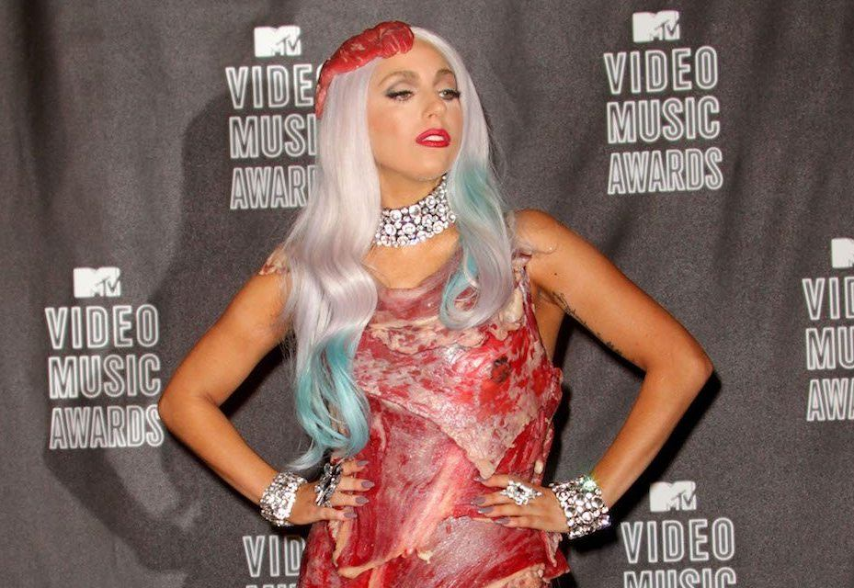
What is the value
conveyed by these brands?

Slide 21
Every Business conveys a Narrative.
Every Narrative starts from the creation of a Core Story

Slide 22
The Core Story
The Core Story is something that becomes a motivating beacon for employees, and ensures that the company communicates a clear and concise message
For management, the first step in developing the company’s Core Story is to create a shared mental image of the company’s reason for being

Slide 23
The core Story tells the way a company makes a difference in the world

Slide 24
Values —> Story
Values in themselves are just words, devoid of any real content. With storytelling, we move from perceiving a brand as a set of brand-values to working with the brand as a living, core story
Brand Values
Core Story
A story puts those values into perspective and into a human context. Those values then make sense and speak both reason and emotions. The goal is to establish a consistent image of the company brand both internally and externally

Slide 25

The 5-steps process to create a Core Story
The Obituary test: What would your company’s obituary look like?
Screening the Basic Data: internally: what characterises the company’s identity? Externally: what characterizes the company’s image?
Distilling the Basic Data: What is the essence of the company’s identity that were combined with the external perception of the company’s image, can be turned into a strong corporate brand?
Formulating the Core Story: conflict + characters + plot + message
The Acid test: is the company’s core story unique?

Slide 26
Step 1 - The Obituary Test
What would the company’s obituary look like?
Would the Company be missed?
Write down your Company’s obituary
How would the obituary read if your customers were to write it?
What would the world look like if the company didn’t exist?
If the company were to close tomorrow, who would miss it and why?
Has the company made any real difference for its stakeholders?

Slide 27
Step 2 - Screening the Basic Data
Internal Basic Data: define the company’s culture, the identity within the business:
IN: Company vision, mission, values
IN: Company milestones
IN: Employees’ stories
External Basic Data: map the company’s position on the market:
EX: Market trends; Customers and key decision-makers
EX: Partners and Opinion leaders

Slide 28
Step 3 - Distilling the Basic Data
Streamline the company’s identity with the external perception of the company
identity
image
core
story

Slide 29
Step 4 - Formulating the Company CS
How does the company makes a difference?
Message = the moral of the story
Conflict = developing a conflict is about defining 2 opposites: define the complete opposite of the brand can help to close in on the company CS
Characters = Hero; Shadow; Messenger; Mentor; Guardian(s); Trickster; Shape-Shifter;
Plot = the 7 basic plots

Slide 30
Step 5 - the Acid test
The company’s CS is unique in relation to the competitors?
Find a story that resonate with your CS: David and Goliath? Robin Hood? Sherlock Holmes? The Ugly Ducklings? The Little Mermaid?

Slide 31
The company Core Story must be transformed into a collection of concrete stories relevant for the employees, customers, stakeholders

